Slide 1
Alzheimer’s Disease & Related Dementias-Population Health, Prevention, Genetics, Risk & Resilience
Gareth Howell, Ph.D.,
Associate Professor,
The Jackson Lab, Bar Harbor, ME.

Slide 2

The prevalence of Alzheimer’s disease is on the increase
AD Prevalence
2005
2010
2015
2020
2030
2040
2050
0
20
40
60
80
100
120
Currently, there is no cure
400 clinical trials – essentially all have failed
Alzheimer’s care will reach $1 trillion by 2050 (unsupportable)
millions

Slide 3
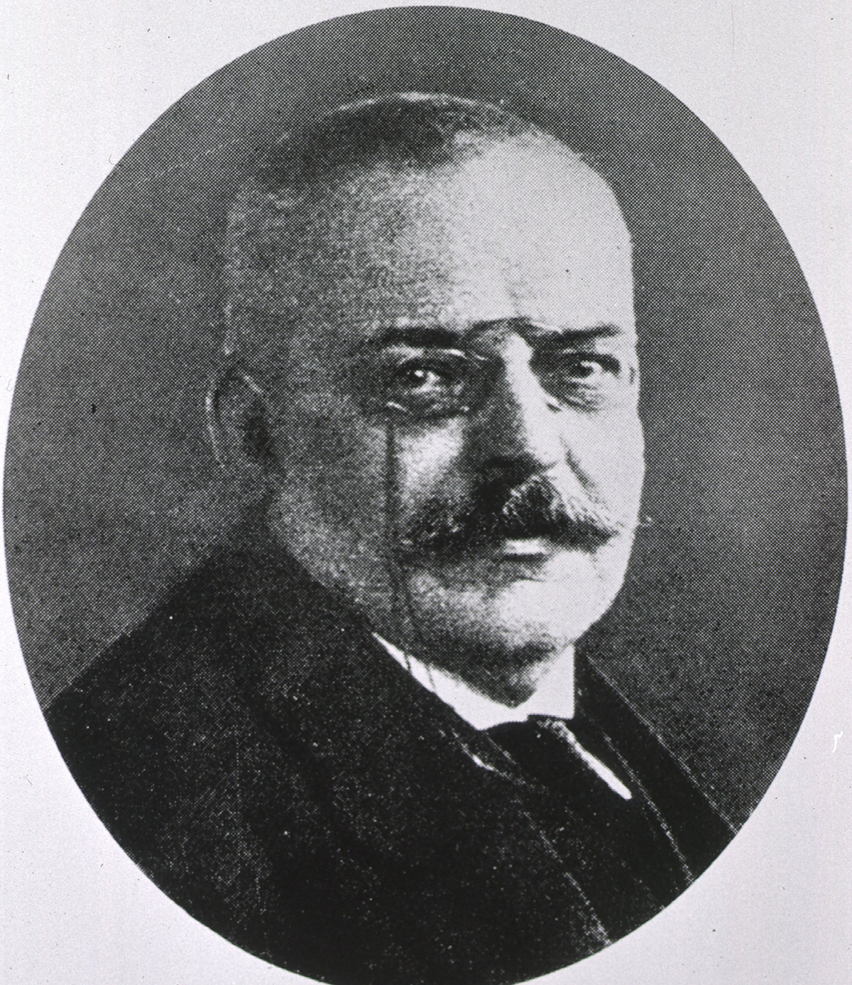
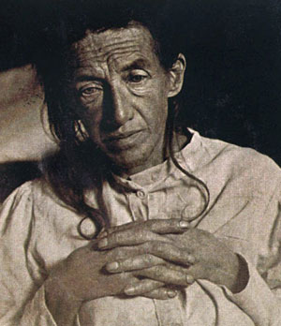
Alzheimer’s disease
Auguste Deter – taken in 1906 shortly before her death, during her stay at Frankfurt’s City Mental Institution.
She was diagnosed with presenile dementia.
Results of the autopsy: described two abnormalities: neurofibrillary tangles and amyloid plaques,

Slide 4
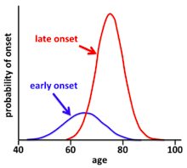
At least two different types of AD
Total AD cases

Slide 5
EOAD is caused by mutations in APP or APP-related genes
Early Onset
Alzheimer’s disease
X-linked diseases
APP
PS1
Essentially a monogenic disorder

Slide 6
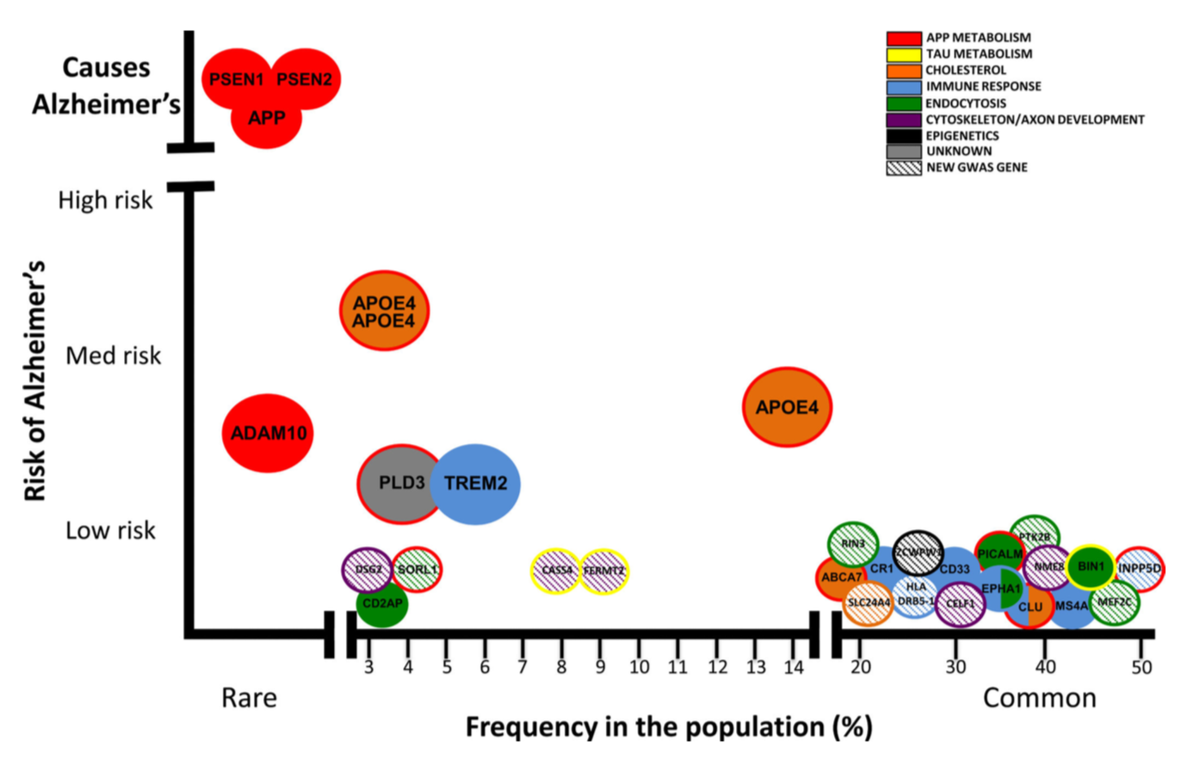
Genetics of AD support 2 types of AD
Karch and Goate, Biol Psychiatry 2015

Slide 7
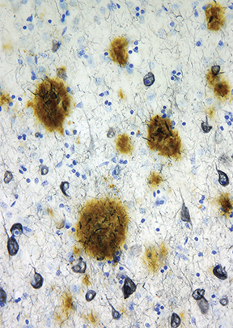
Mouse models have copied EOAD – kind of…
APP^{swe}
Plaques by 17-18 mos
APP^{swe}PSEN1^{de9}
Plaques by 6 mos
5xFAD (3xAPP, 2xPSEN1)
Plaques by 2 mos, nerve cell loss in striatum
3xTG (APP, PSEN1, MAPT)
Plaques by 9 mos, Tau phosphorylation
Data from Alzforum

Slide 8

Out of more than 400 clinical trials for Alzheimer’s disease in the last 10 years, 99.6% of them failed
X
Preclinical
trials
Clinical
trials
Discovery

Slide 9
No or little nerve cell loss in current models of EOAD

Slide 10
National Plan to Address Alzheimer’s disease (NAPA)
Prevent and effectively treat Alzheimer’s disease by 2025

Slide 11
Recommendations from 2015 AD Summit
Develop the next generation of in vivo models based on human data to explore Alzheimer’s and related dementia
Establish a standardized and rigorous process for the development and characterization of animal models, and ensuring their maximal and rapid availability to all researchers for preclinical drug development
Align the pathophysiological features of AD animal models with the corresponding stages of clinical disease using translatable biomarkers
Establish guidelines for rigorous preclinical testing in animal models and reporting of both positive and negative findings
NIA Funding Initiative RFA AG16-04
MODEL-AD Consortium
Model Organism Development and Evaluation for
Late-onset Alzheimer’s Disease
Expand animal model resources for basic research and preclinical testing of candidate therapeutics with 50 new mouse models of AD and AD pathology.

Slide 12
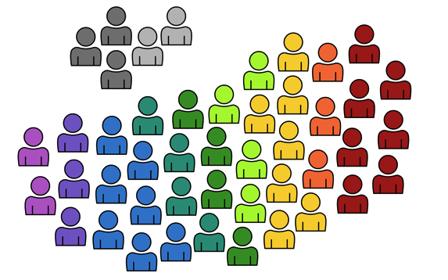
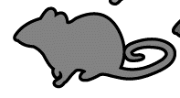
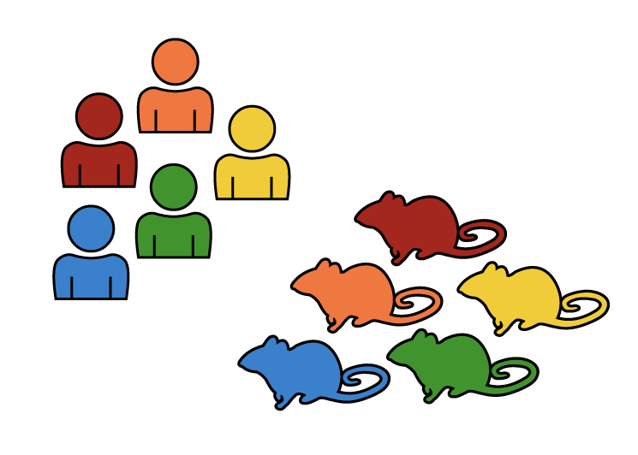
MODEL-AD Goals
Early Onset
AD (< 5%)
Existing
Models
New
Models
Late Onset
AD (> 95%)
Prioritize LOAD variants for animal modeling
Create new mouse models with CRISPR (piloting rat models)
High-capacity screening of all models, deep phenotyping of promising models
Alignment of mouse and human phenotypes (neuropath, ’omics, imaging)
Preclinical testing of the most promising models and therapeutics
Broad, unrestricted distribution of all data and models
Bioinformatics and Data Management Core
The Jackson Lab Sage Bionetworks
Indiana U UC Irvine
Disease Modeling Project
The Jackson Lab
Indiana U U Pitt UC Irvine
Preclinical Testing Core
Indiana U The Jackson Lab
U Pitt Sage Bionetworks

Slide 13
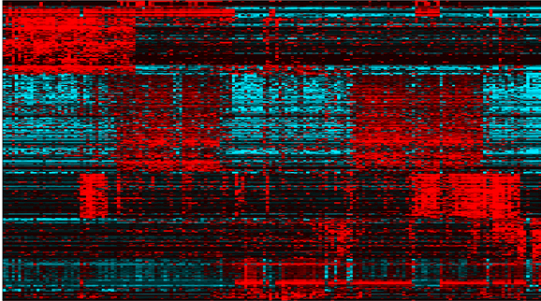
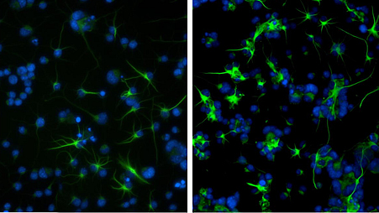
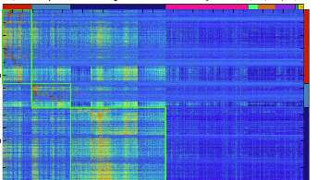
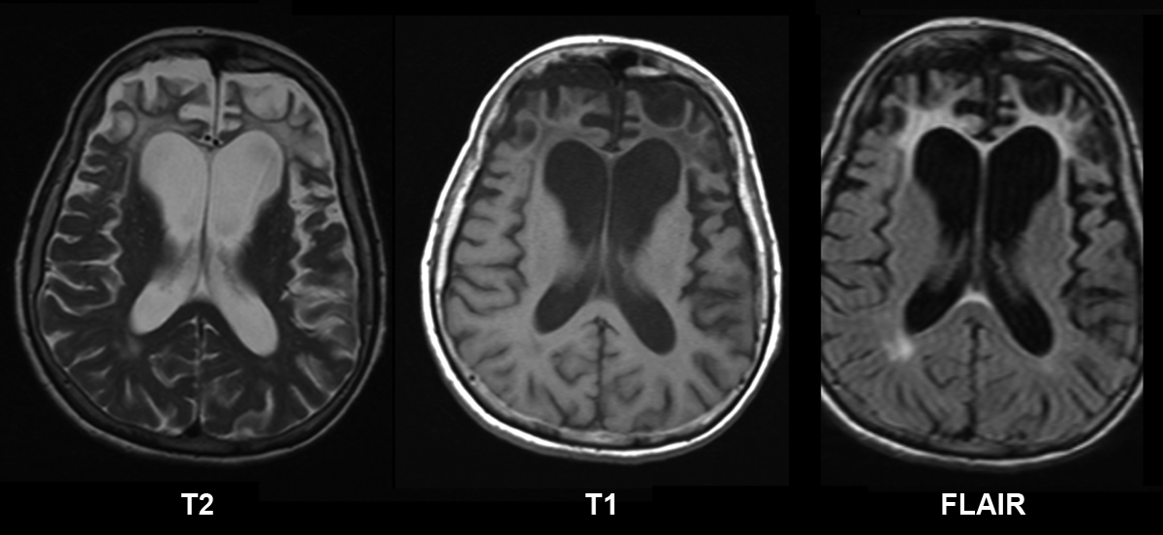
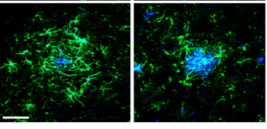
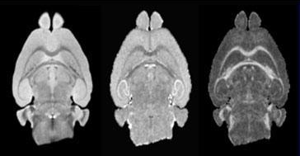
MODEL-AD creation and matching new mouse models to human AD
clinical study cohorts
‘Omics
Neuropathology
Brain Imaging
mouse models
Over 50 new models in 5 years

Slide 14
Use strong genetic risk factors to model LOAD
Karch and Goate, Biol Psychiatry 2015

Slide 15
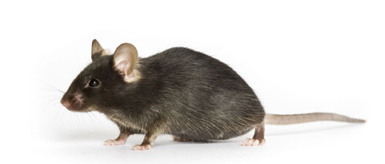
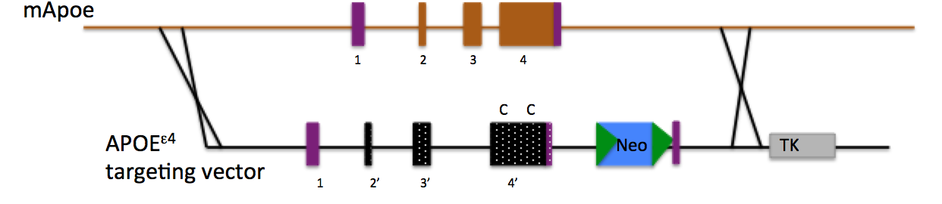
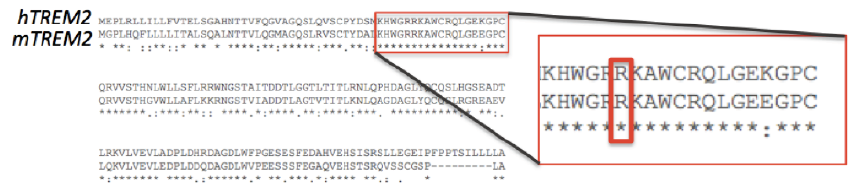
Baseline strains relevant to LOAD
C57BL/6J
3. Humanized AB
Hs Aβ
DAEFRHDSGYEVHHQKLVFFAEDVGSNKGAIIGLMVGGVVIA
Mm Aβ
DAEFGHDSGFEVRHQKLVFFAEDVGSNKGAIIGLMVGGVVIA
1. Humanized APOE^{E4}
β-Secretase
+1
γ-Secretase
+40 +42
1. B6J.APOE4
2. B6J.APOE4.TREM2*R47H
3. B6J.APOE4.TREM2*R47H.hAβ
2. Humanized Trem2*R47H
4. B6J.APOE4.Trem2*R47H.hAβ.hTAU

Slide 16
An age-dependent increase in frailty index score but no cognitive decline in B6J.APOE4.Trem2*R47H

Slide 17
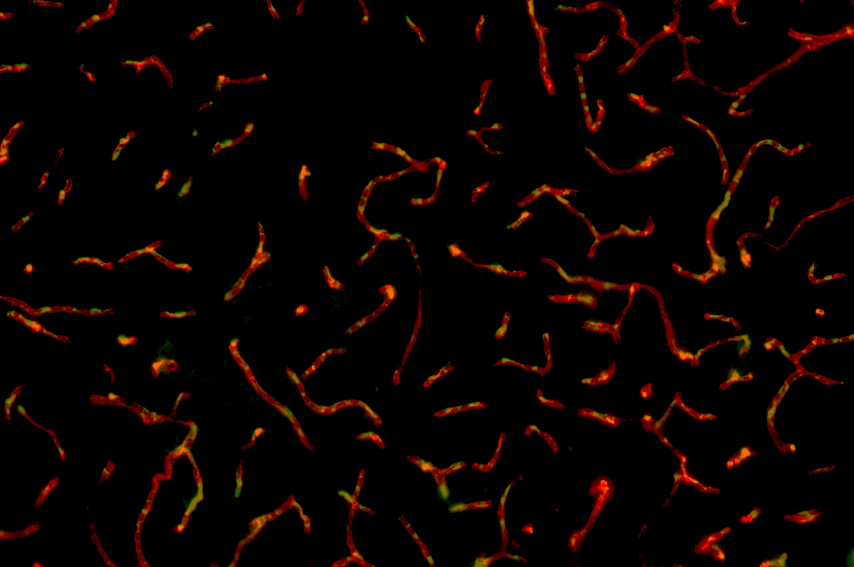
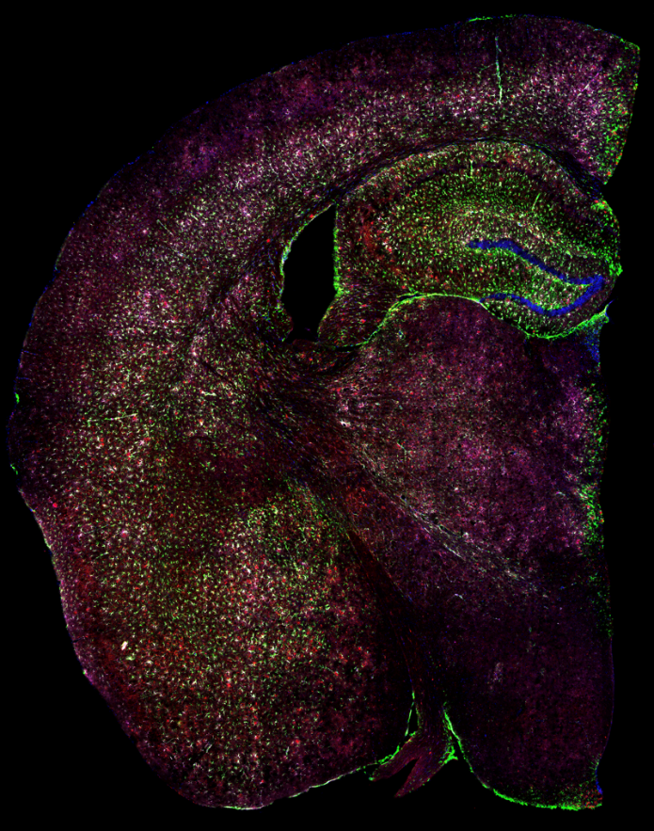
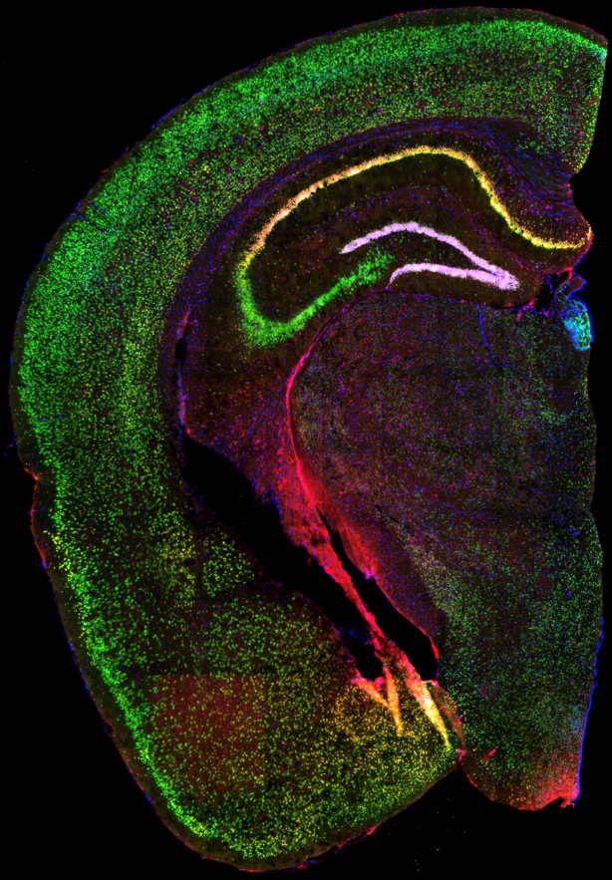
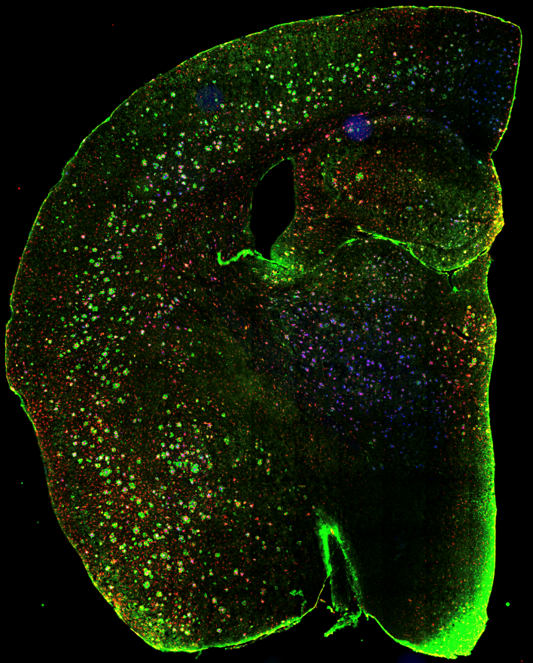
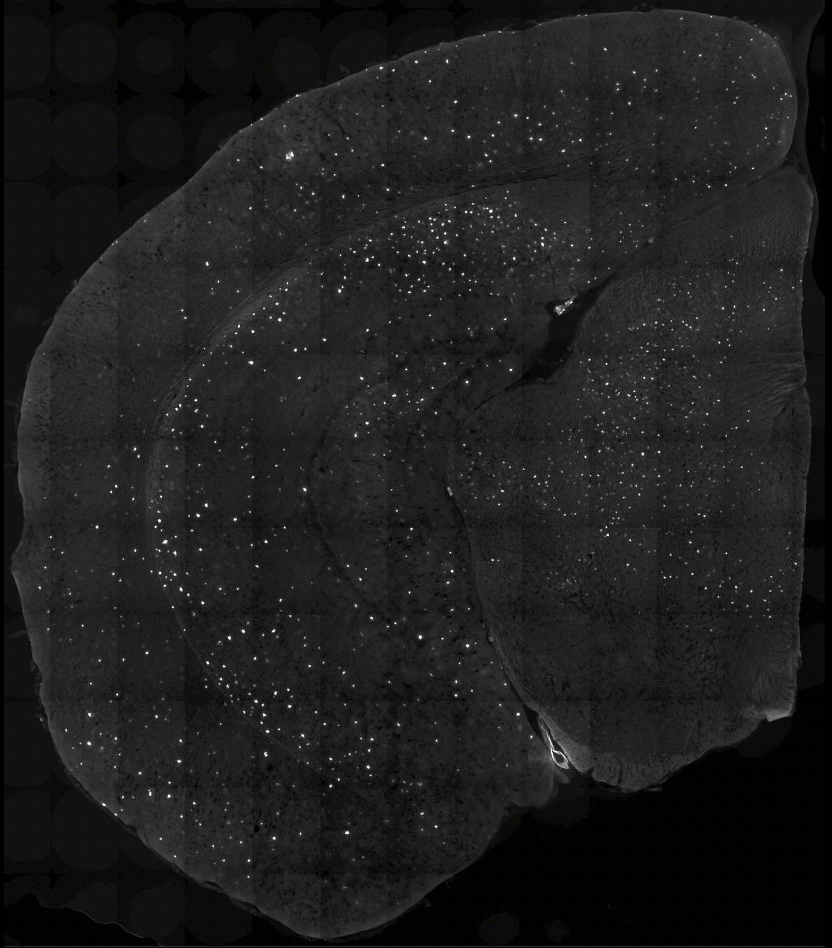
Neuropathology to determine AD-relevant features in B6J.APOE4.Trem2*R47H
Cerebrovascular health
Lectin Fibrin
Glial cells
Neurons
Plaque associated microglia
Plaques
GFAP S100B IBA1 DAPI
NeuN CTIP DAPI
X34 LAMP1 IBA1
ThioS

Slide 18
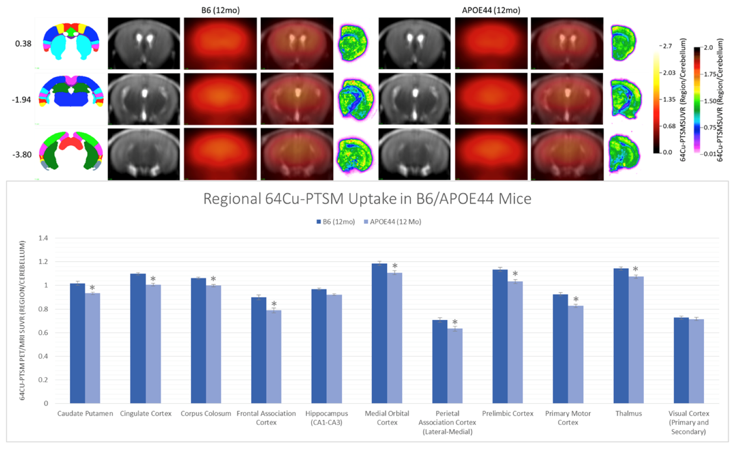


Assessing cerebral perfusion (⁶⁴Cu-PTSM) and glucose uptake (¹⁸F-FDG PET) in B6J.APOE4.Trem2*R47H
Study Characteristics
3T T2W 3DSPACE MRI
64Cu-PTSM PET Imaging
Conscious tail veil dosing
Autorad Primary Confirmation
IHC Secondary Confirmation
Offline Co-Registration
Paxinos-Franklin Atlas
56/27 PET/Autorad Regions
PCA + One-Way ANOVA
Mean±SEM, *p<0.0001
Corpus Callosum
Thalamus

Slide 19
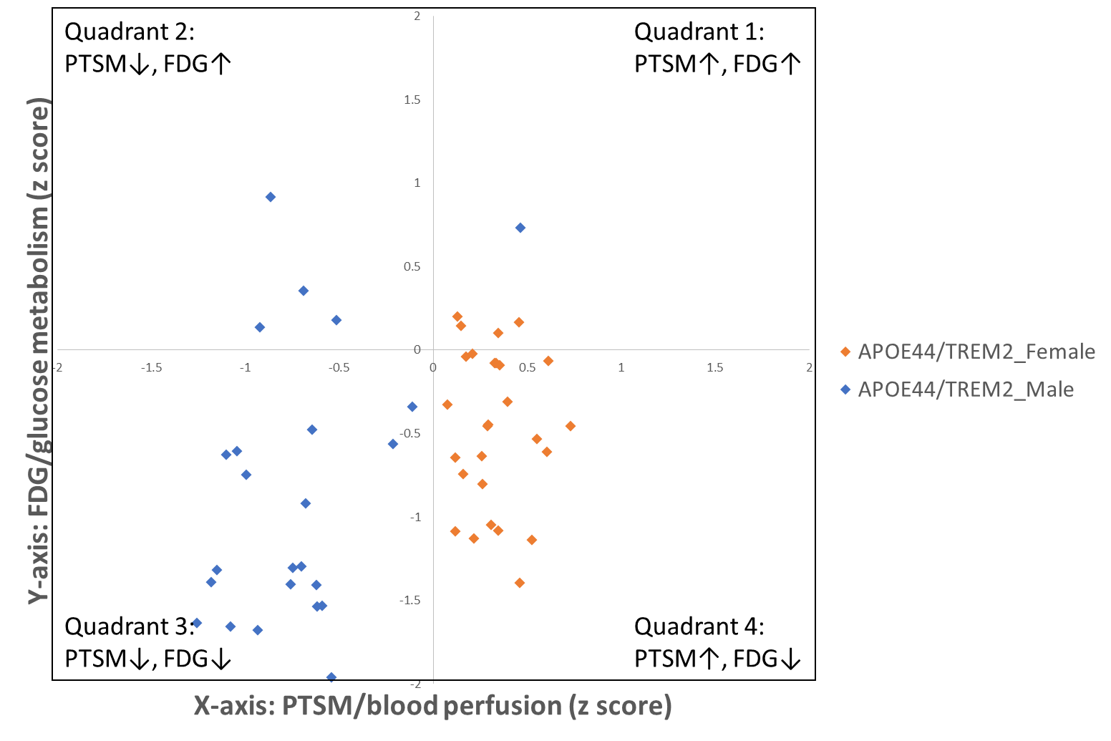
Sex-specific modifications in perfusion and metabolism in B6.APOE4.Trem2*R47H mice
B6.APOE4.Trem2*R47H – Analysis
$$Z(s,g,a)= \frac{R\left(s,g,a\right)−μ_{B6, 8mo}}{σ_{B6,8mo}}$$
R=region, s=sex, g=genotype, a=age
Mean ± StDev
n = 10/region/sex/age/genotype/tracer

Slide 20
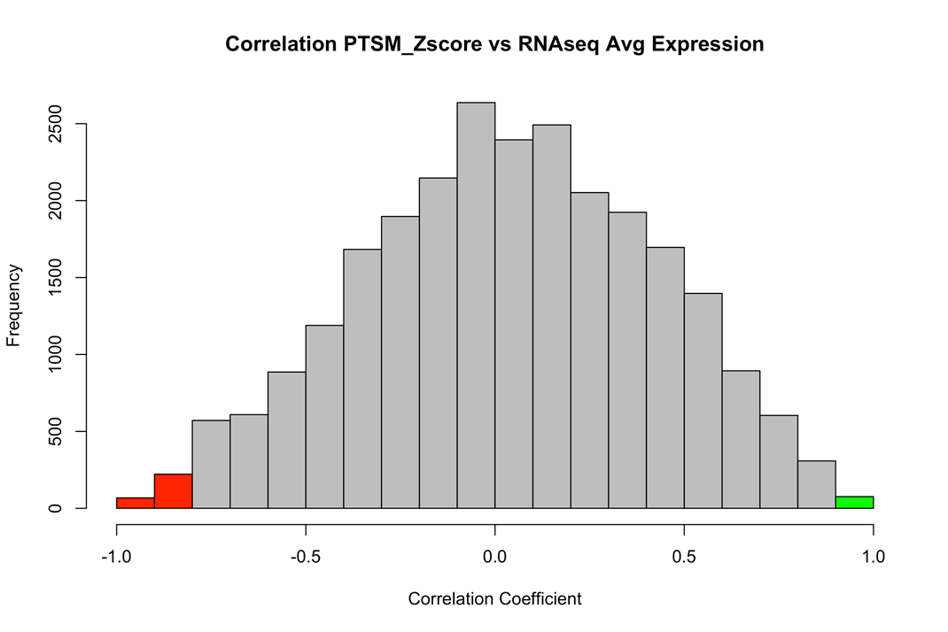
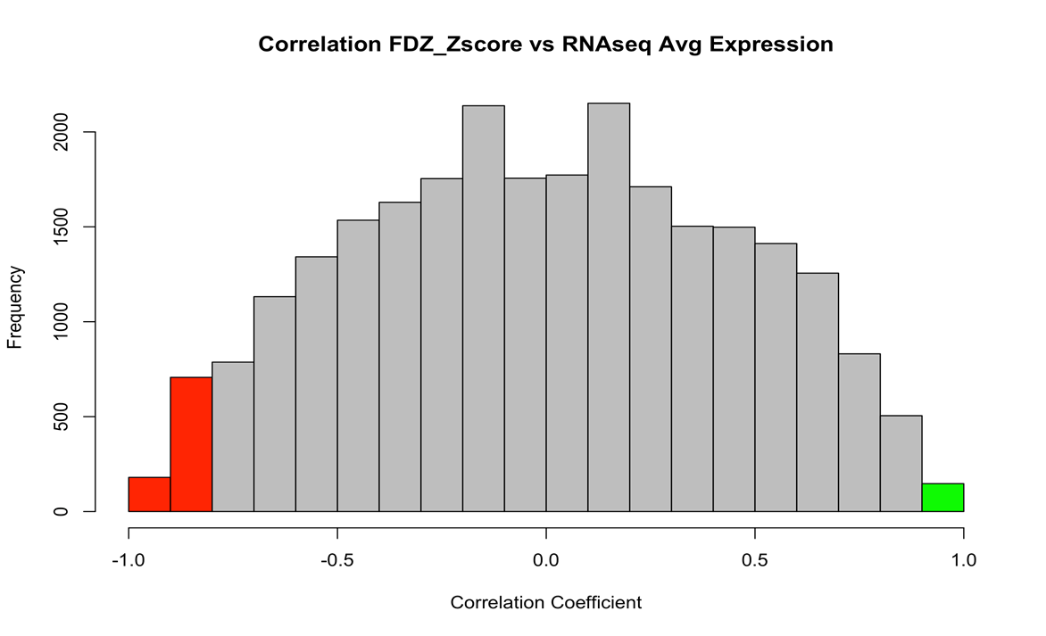
Correlating PTSM and FDG with gene expression in B6J.APOE4.Trem2*R47H (B6.hAT)mice
Notes:
587 and 810 for FDG
346 and 246 for PTSM

Slide 21
Modeling susceptibility loci in mice: What to do with GWAS variants?
Karch and Goate, Biol Psychiatry 2015

Slide 22
Leveraging the AD Data Universe
MODEL-AD
Genetics
case/control,
imaging, ’omics
’Omics
transcriptomes, proteomes, metabolomes
brain, serum, CSF
Imaging
brain MRI, PET
Cognition
MMSE, mood
ADSP
AMP-AD
ADNI
ROS/MAP
IGAP
M²OVE-AD
Resilience-AD
ACT
Notes:
All this data allows us to redefine AD in a mouse.
NIA Integrated Program Development

Slide 23
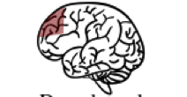
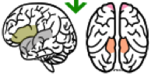
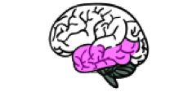
Human-relevant data resources in AMP-AD
Study | N | Brain Regions |  | Study
ROS/MAP | 700 |  | dorsolateral prefrontal cortex | de Jager, et al PMID 30084846
Mt Sinai Brain Bank | 300 |  | frontal pole superiortemporal gyrus parahippocampal gyrus inferiorfrontal gyrus | Wang M, et al PMID 30204156
Mayo Clinic | 270 |  | cerebellum temporal cortex | Allen M, et al PMID 27727239

Slide 24
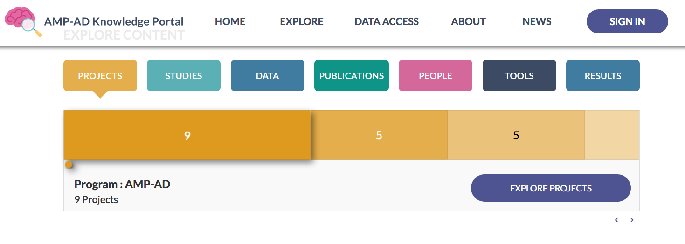
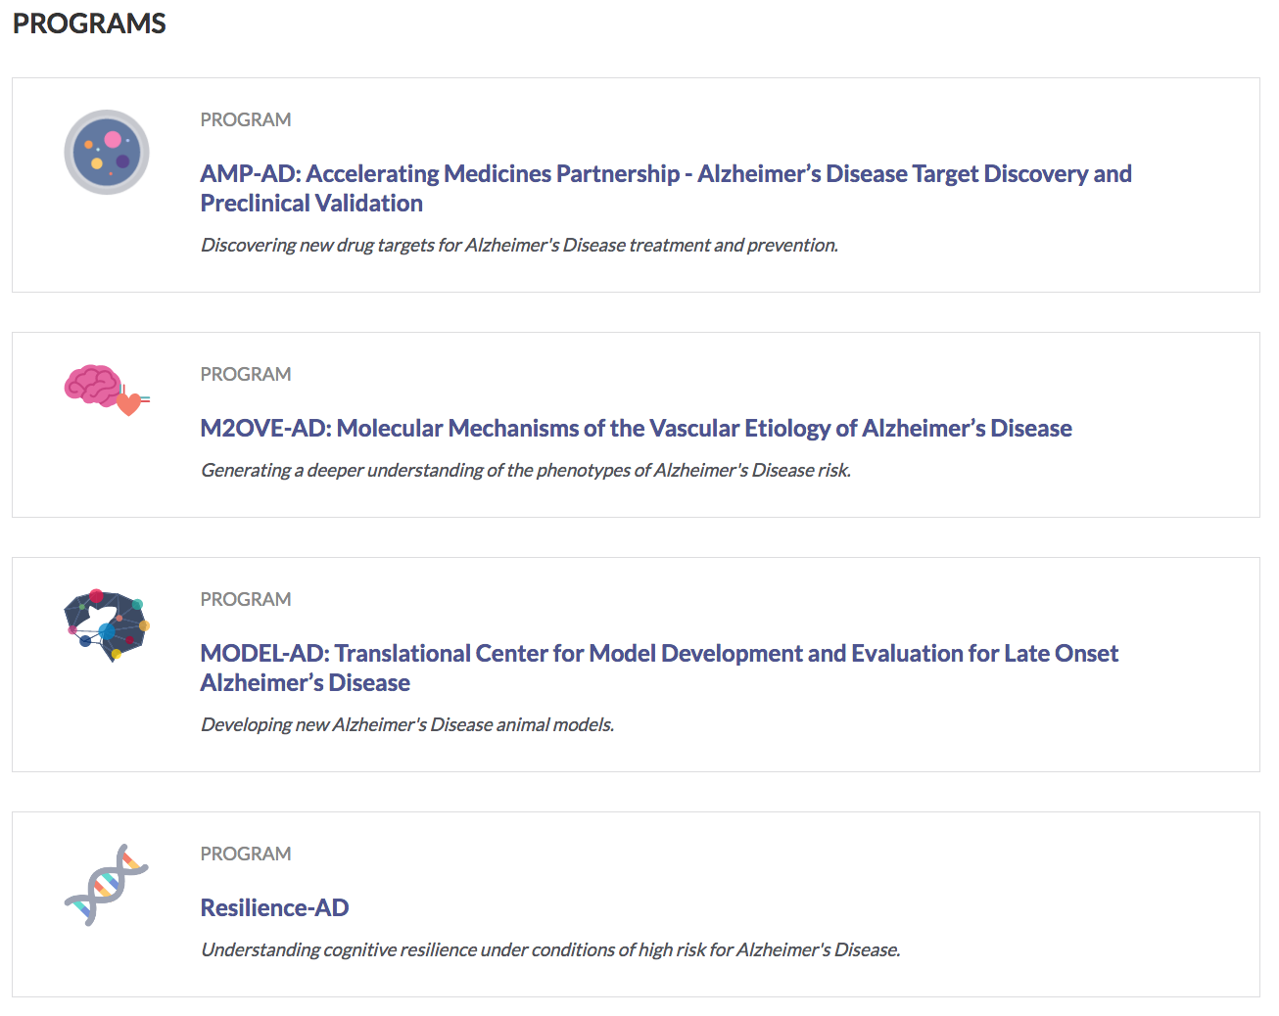
The AMP-AD knowledge portal

Slide 25
Variant prioritization
Vascular health
Significance in multiple studies
Predicted effect on function
Human-mouse sequence conservation
Differential expression in AD
Mitochondria and
Metabolism
MEOX2
Lipid
homeostasis
MTHFR,
PTPRB
APOE
MTHFDL1, SPG7, TOMM40
APOC1
CLU*
ABCA7
WDR81
CD33, CLNK, CR1, CSF1R, HMHA1, IL1RAP, MYO1C, PLCG2, PMSA1, SPI1, STAT3, STAT4, TREM2,TREM2*,
TYROBP,
ADAMTS4, IL34,
PILRA, SCIMP,
IL1RAP
FERMT2,
SORL1
ABCA7*
NCR2,
PLXNC1
ABI3, ADAM10, ADAMTS4, ANK1, APH1B, ASGR2, CD2AP, CDH23, CEACAM1, EPHA1, GUCY2D, INPP5D, ITM2C, ITGAX, MS4A4E, MS4A4A, MTMR4, MYO10, PCNT, PODXL, PSTPIP1, PVRL2, SLC15A4, SLC16A3, SNX1, UNX1,
CD2AP
Immune
system
HLA-
DRB5
BCHE, BIN1,
BIN1, CLASP2, EXOC3L2, HTR4, KCNN4, SLC6A17, SLC24A4, EPHA1
PTK2B,
PDGFA, RHBDF2
INFORMATICS IN PROGRESS
Primary screen complete @ IU/JAX
Breeding F0→N2 @ IU/JAX
CRISPR in progress @ IU/JAX
Breeding F0→N2 @ UCI
Cohorts established @ UCI
* Distinct alleles at IU/JAX or UCI
ERC2,
KIF21B,
PICALM,SHC2, PTK2B
Plasma/Membrane/
ECM
Synaptic Signaling
Transcriptional regulator
HESX1, KAT8
Unknown / unclear
IQCK

Slide 26

Using B6.APOE4.Trem2*R47H mice as a sensitizer to assess low effect variants
APOE/TREM2 + ABCA7
APOE + TREM2
APOE/TREM2 + CR1
CRISPR
APOE/TREM2 + PLA2G4A
MODEL-AD

Slide 27

New models in strain validation and primary screening
Locus | Allele (Human) | Allele (Mouse) | SNP | Type | Is allele conserved in mouse? | JAX model #
ABCA7 | A1527G | A1541G | rs3752246 | missense | yes | 30283
CEACAM1 | LOF rare variants | KO | --- | KO | --- | 30673
CLASP2 | L163P | L163P | rs61738888 | missense | yes | 31944
CR1 | --- | --- | --- | humanized locus | no | 31668
IL1RAP | intronic SNP | KO | rs12053868 | KO | --- | 30304
KIF21B | T82 (ACG->ACA) | T82 (ACG>ACA) | rs7556510 | synonomous | yes | 31938
MEOX2 | CNV | KO | --- | KO | --- | 33770
MTHFR | A222V (c677C>T) | A262V | rs1801133 | missense | yes | 30922
B6J.APOE4.
TREM2*R47H
Locus | Allele (Human) | Allele (Mouse) | SNP | Type | Is allele conserved in mouse? | JAX model #
MTMR4 | V297G | V297G | rs2302189 | missense | yes | 31950
PLCG2 | M28L | M28L | rs61749044 | missense | yes | 30674
SHC2 | V577M | V433M | rs61749990 | missense | yes | 31952
SLC6A17 | P61 (CCG>CCA) | P61 (CCA->CCG) | rs41281364 | synonymous | yes | 31948
SNX1 | D466N | D465N | rs1802376 | missense | yes | 31942
SORL1 | A528T | A528T | rs2298813 | missense | yes | 31940

Slide 28
Matching AD-relevant transcript signatures in humans and mice
Study | N | Brain Regions |  | Study
ROS/MAP | 700 |  | dorsolateral prefrontal cortex | de Jager, et al PMID 30084846
Mt Sinai Brain Bank | 300 |  | frontal pole superiortemporal gyrus parahippocampal gyrus inferiorfrontal gyrus | Wang M, et al PMID 30204156
Mayo Clinic | 270 |  | cerebellum temporal cortex | Allen M, et al PMID 27727239

Slide 29
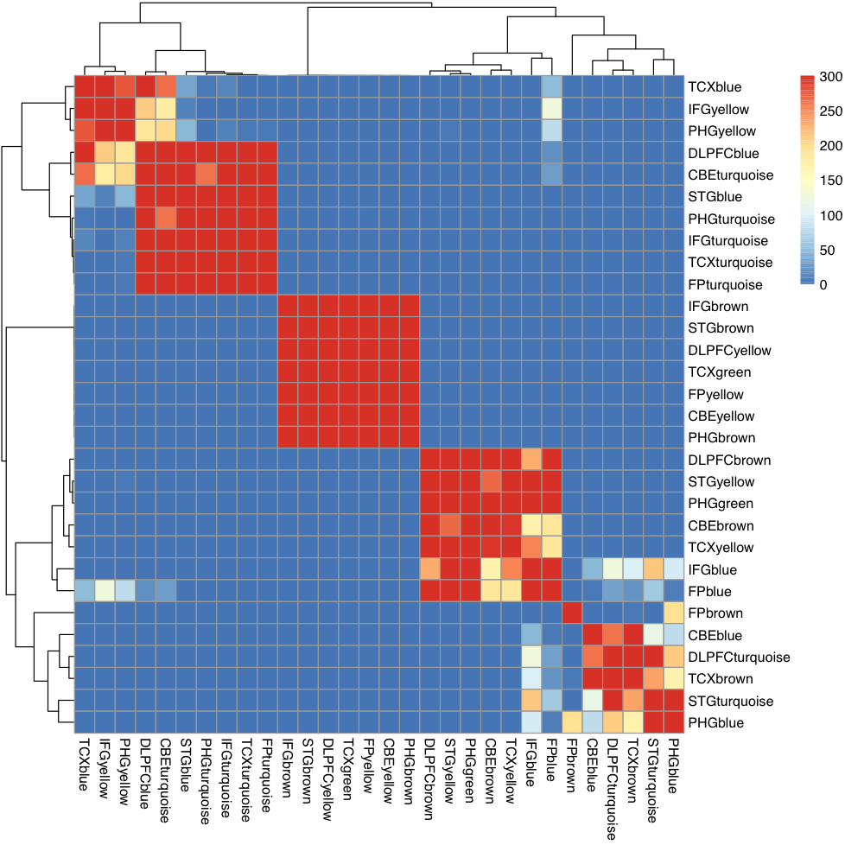
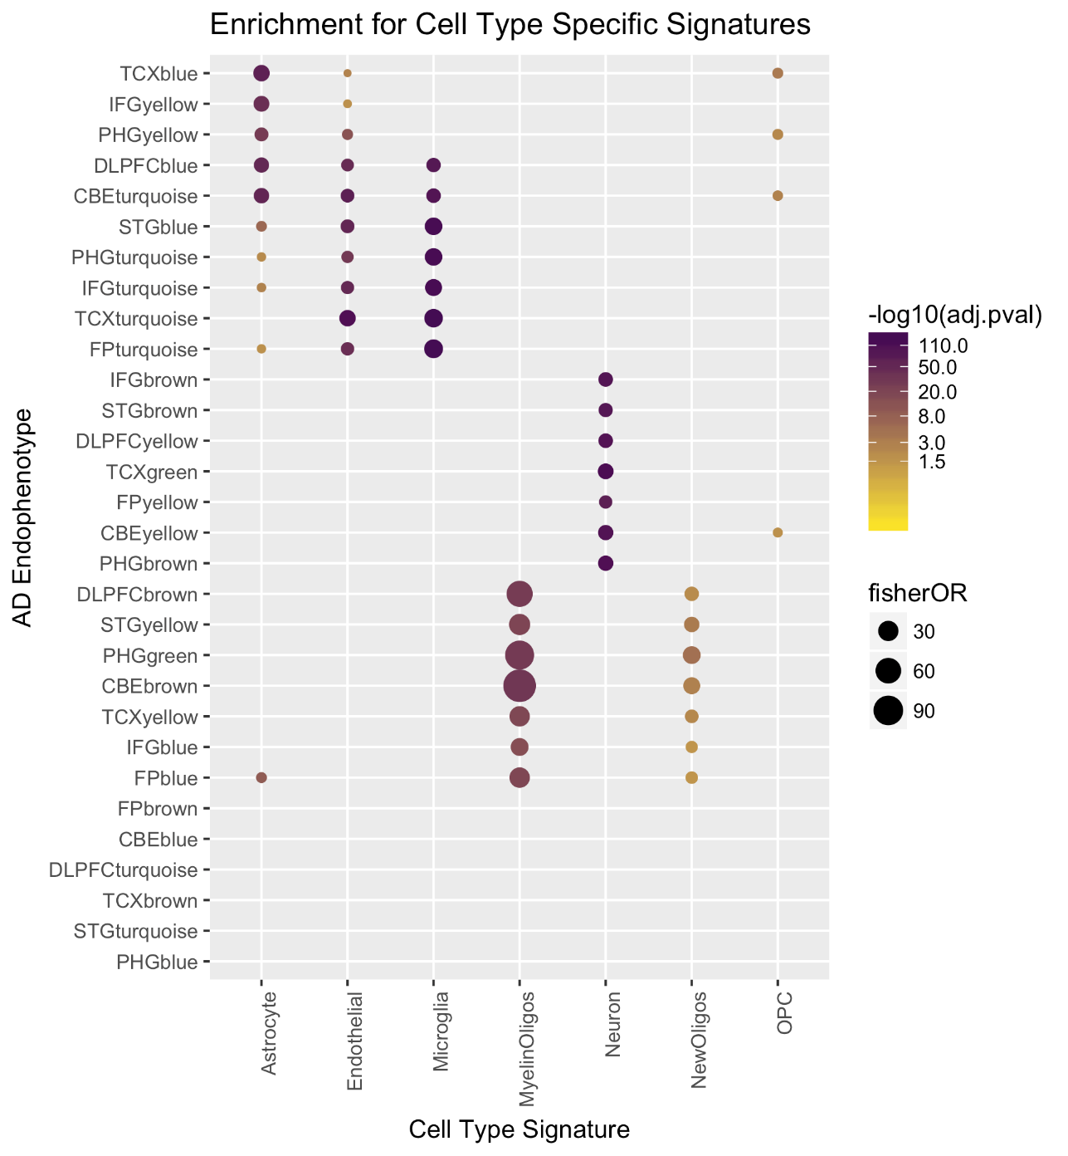
The AMP-AD modules for LOAD
AD Astrocytes
AD Astrocytes, AD Endothelial, AD Microglia
AD Neuron
AD Oligodendrocyte glial cells
NOT CELL TYPE SPECIFIC
AD Heat Shock Response
AD Response to Unfolded Proteins
Logsdon, et al bioRxiv 510420

Slide 30
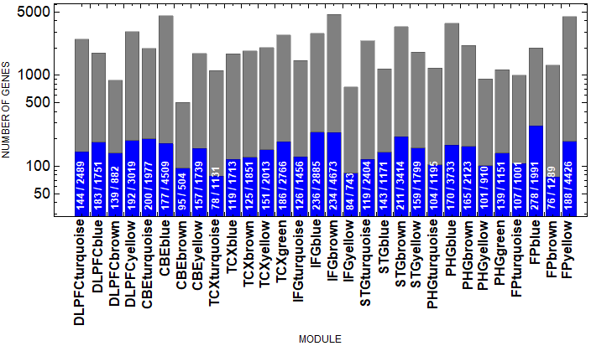
The Mouse-AD panel: coverage by module
NUMBER OF GENES
GENE MODULE
FOR RESEARCH USE ONLY. Not for use in diagnostic procedures.

Slide 31
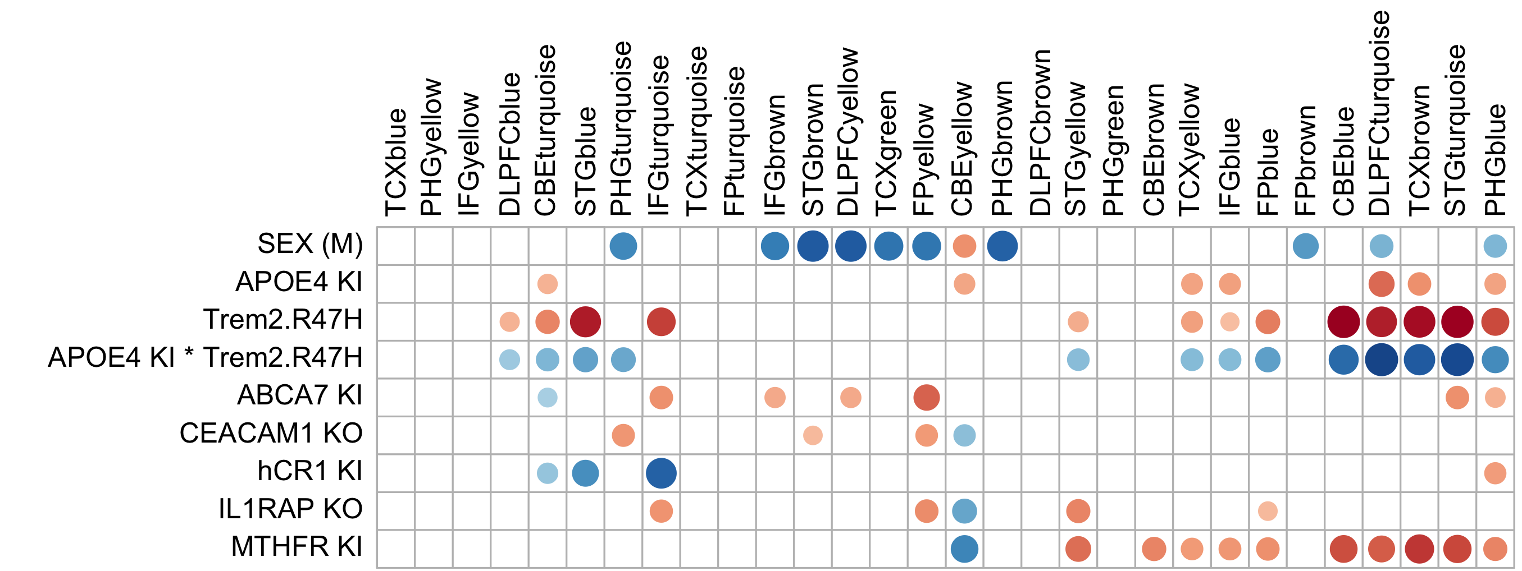
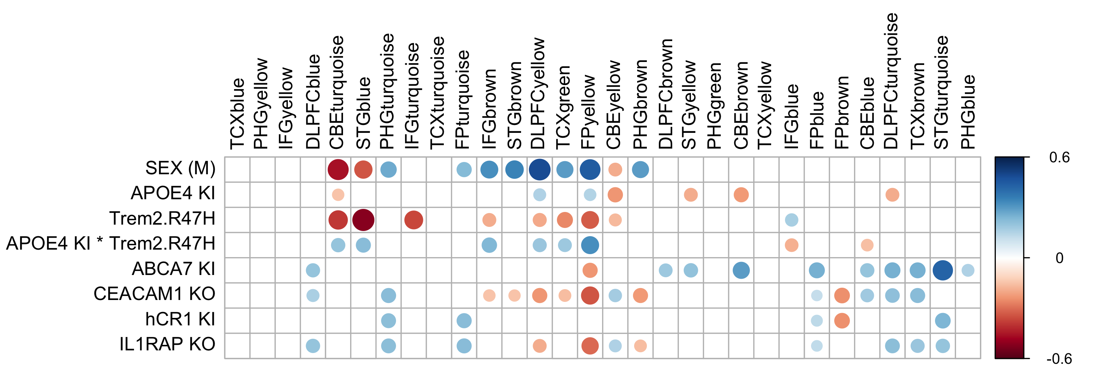
Aligning human and mouse transcriptomes
Consensus Cluster A
ECM organization
Consensus Cluster B
immune response,
cytokine signaling
Consensus Cluster C
synaptic signaling,
neural system
Consensus Cluster D
myelination, neuron and
glial development, astrocytes
Consensus Cluster E
cell cycle, DNA repair, RNA metabolism
4 MONTHS
12 MONTHS
Notes:
Overall trend of reds to blues as mice age. ABCA7, IL1RAP, CR1 get interesting.

Slide 32
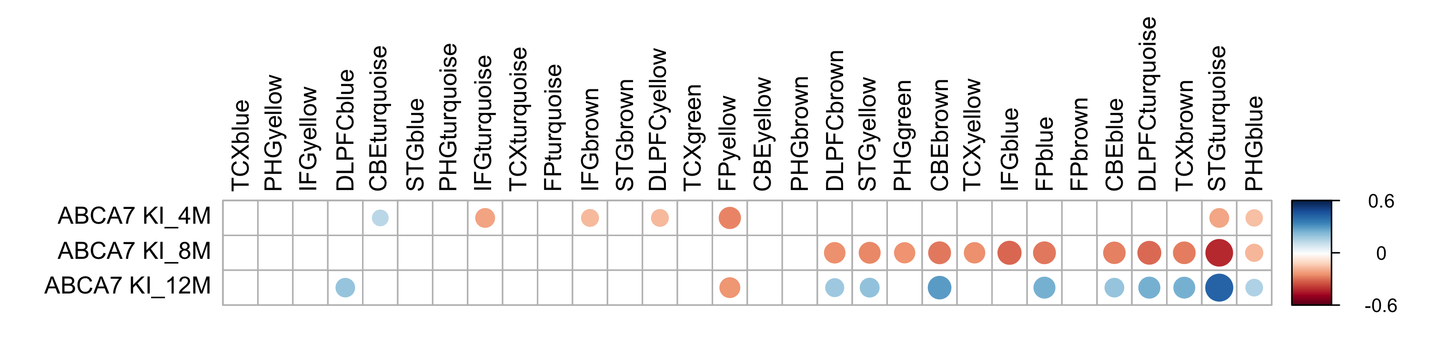
Aligning human and mouse transcriptomes
Go/No-go decision for ABCA7 KI
Consensus Cluster A
ECM organization
Consensus Cluster B
immune response,
cytokine signaling
Consensus Cluster C
synaptic signaling,
neural system
Consensus Cluster D
myelination, neuron and
glial development, astrocytes
Consensus Cluster E
cell cycle, DNA repair, RNA metabolism
Notes:
Overall trend of reds to blues as mice age. ABCA7, IL1RAP, CR1 get interesting.

Slide 33

Phenotyping of baseline strains (IU/JAX)
TIMELINE PHENOTYPING PIPELINE (months)
Pathology
Biochemistry
4
6
8
12
18
24
B6J.5xFAD
PET/MRI
B6J
B6J.APOE4
Network analysis (RNAseq)
B6J.Trem2*R47H
B6J.APOE4.
Trem2*R47H
*no PET/MR at 24 months
B6J.APOE4.
Trem2*R47H.hAβ
B6J.APOE4.
Trem2*R47H. hAβ .ABCA7*A1527G
Phenotyping almost done
Phenotyping in progress
Cohorts being established

Slide 34
Genetic context matters!
Almost all work to date has been performed on a single genetic background: C57BL/6J (B6)

Slide 35

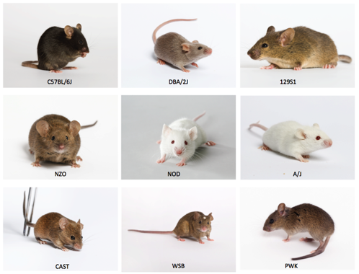

A genetically diverse inbred strain panel for modeling AD
Kristen Onos
APP/PS1 transgenes backcrossed at least 7 generations to genetically diverse inbred mouse strains
Hongtian
Stanley Yang

Slide 36
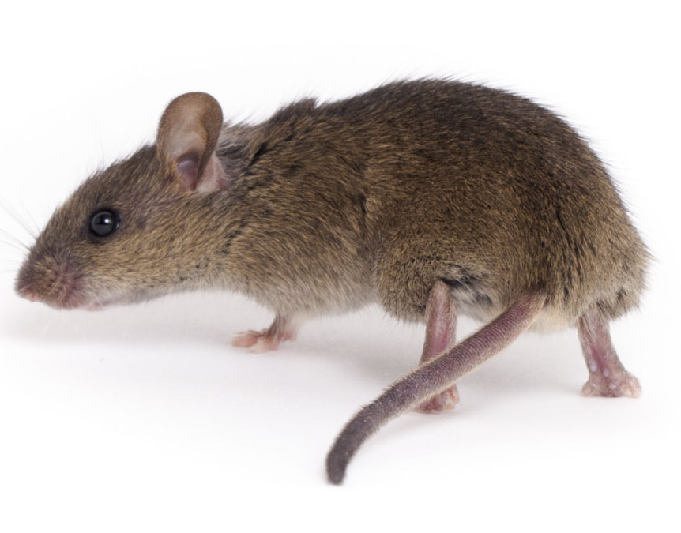
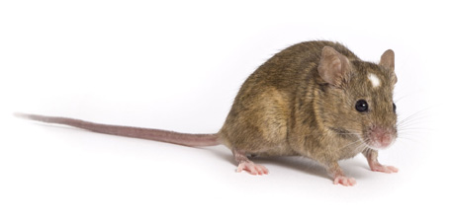
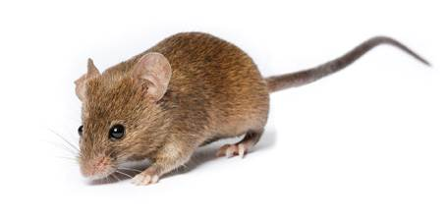
Genetic context matters!
Don’t say something doesn’t happen in mice unless you have tested it on a variety of genetic backgrounds!
PWK/PhJ
WSB/EiJ
CAST/EiJ
C57BL/6J

Slide 37
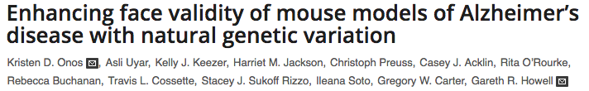
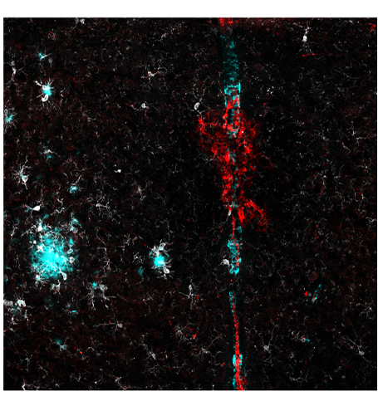
Genetic context is a key consideration for modeling LOAD
B6. APP/PS1
WSB. APP/PS1

Slide 38
Late onset Alzheimer’s disease is complex: genetics may not be enough
Physical Activity
Education
Diet
Smoking
Brain injuries
Genetics

Slide 39
Diet-related factors and physical inactivity are associated with increased risk for AD
Population-attributable risk
Diet/
Exercise

Slide 40
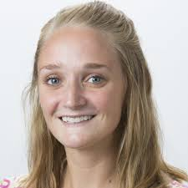
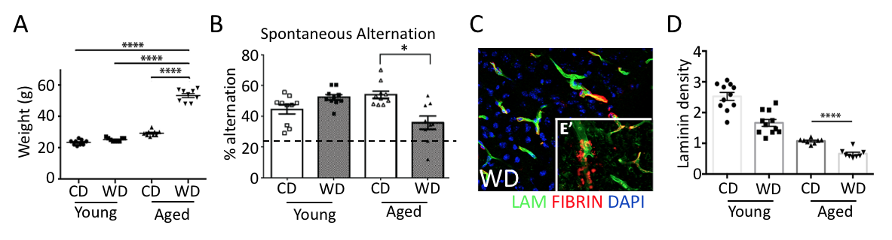
Chronic consumption of western diet causes obesity, cognitive decline and vascular damage
Leah Graham
With the obesity epidemic and the recognition of vascular contributions to AD, will the most common form of dementia continue to be AD or will it become mixed dementia?
How would we treat mixed dementia?

Slide 41


So what’s the good news: How do we prevent or treat Alzheimer’s disease?

Slide 42

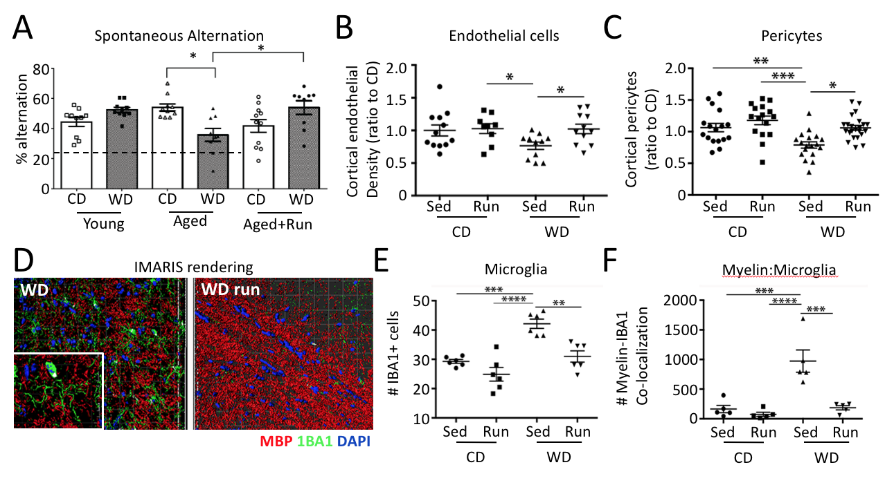
Exercise prevented damaging affects of obesity and aging in one strain of mice

Slide 43
Exercise at a young age modified the brain transcriptome more than at midlife
RNA-seq
You can’t start too early to reduce risk for dementia!

Slide 44

How does genetic risk affect the benefits of exercise during aging?
Kate Foley
Run
B6.APOE^{ε3/ε3}
B6.APOE^{ε3/ε4}
B6.APOE^{ε4/ε4}
Sed
1-2mo
4mo
12mo
In collaboration with Fayeza Ahmed at University of Maine

Slide 45

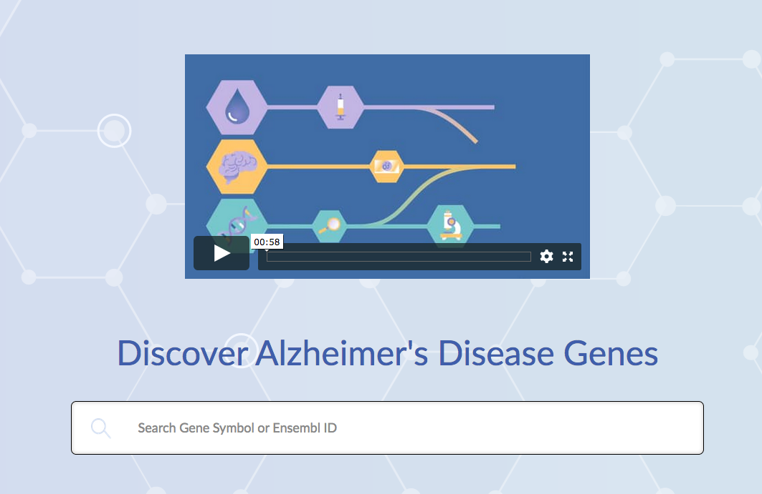
Where are new drug targets coming from?
https://agora.ampadportal.org/genes

Slide 46
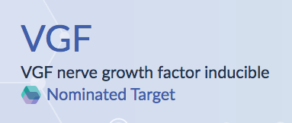
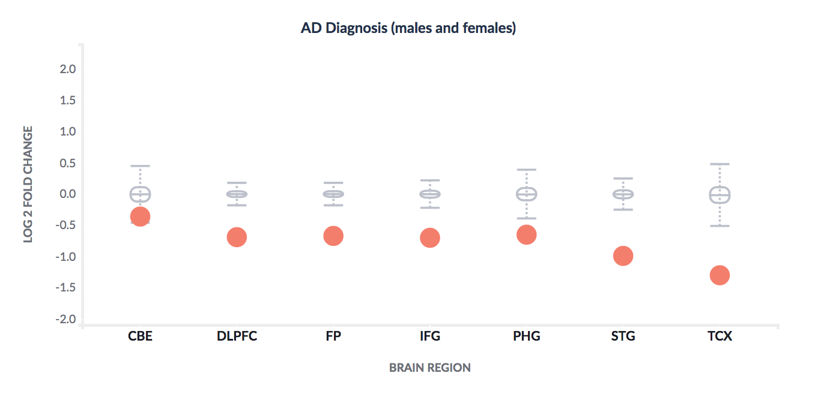
Searching Agora for novel therapeutic targets for Alzheimer’s disease

Slide 47
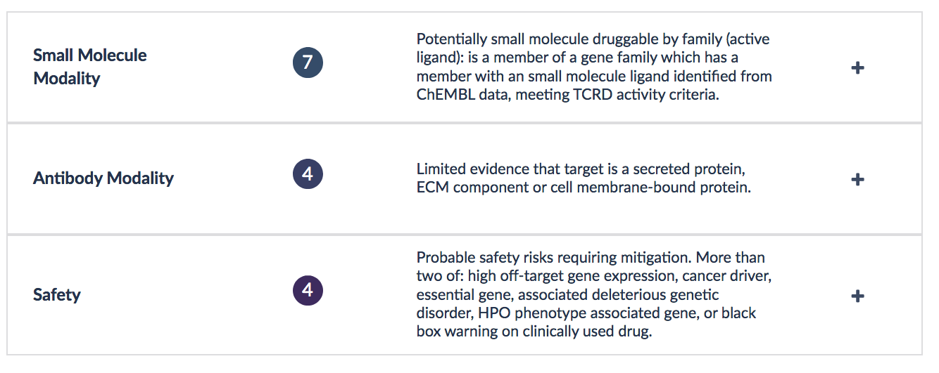
Searching Agora for novel therapeutic targets for Alzheimer’s disease

Slide 48


Genes that show similar expression patterns to VGF may be better druggable targets

Slide 49

Reasons to be optimistic
Our understanding of dementia is becoming ever more precise
Our ability to diagnose those with early stages of dementia (pre-cognitive symptoms) is improving
Our mouse models of dementia will better match the human condition(s)
Data for more precise drug targets is available and ready to be interrogated
The right target for the specific dementia, tested in matching mice

Slide 50





Maine Alzheimer’s disease Research Alliance
Matching human disease to mouse models to improve early diagnosis and develop treatments
Human subjects
Mouse populations
Computational
Scientists
Basic and translational researchers
Clinician Scientists

