Slide 1
Dementia Screening
Sarah Hallen, MD – MMP/MMC Geriatrics
October 2019

Slide 2
Objectives
Brief Review of Dementia (Neurocognitive Disorder) and Clinical Criteria for Diagnosis
Benefits and barriers to screening
One approach to screening (CAM, Mini-Cog)
Next steps (diagnosis)

Slide 3
Dementia Neurocognitive Disorder
DSM V criteria recently stopped using the term “dementia”
The word "dementia" is related to a Latin word for "mad," or "insane”
The introduction of the term “neurocognitive disorder” attempts to help reduce the stigma associated with both the word dementia and the conditions that it refers to
APA acknowledges that because the word dementia is in common use and is easily understood by everyone, it will likely remain in use
Alzheimer’s Association still uses it

Slide 4
Neurocognitive Disorders
Mild
Major
Delirium

Slide 5
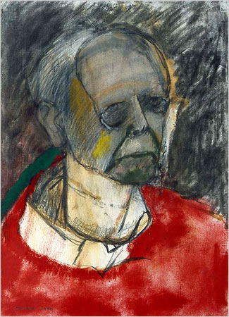
Major NCD
Evidence of substantial cognitive decline from a previous level performance in one or more cognitive domains
Must be sufficient to interfere with daily function
Must be independent from delirium
Not attributable to another mental disorder
Acquired not developmental
DSM V
William Utermohlen

Slide 6
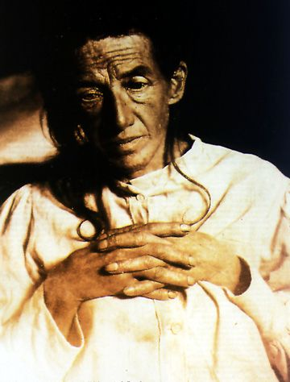
Alzheimer’s Disease
Alzheimer’s disease (AD) is the most common type of dementia
6%‒8% of people >65 yr have Alzheimer dementia (AD)
Prevalence doubles every 5 yr after age 60
Nearly 45% or more of those aged 85+ have AD
Auguste D.

Slide 7
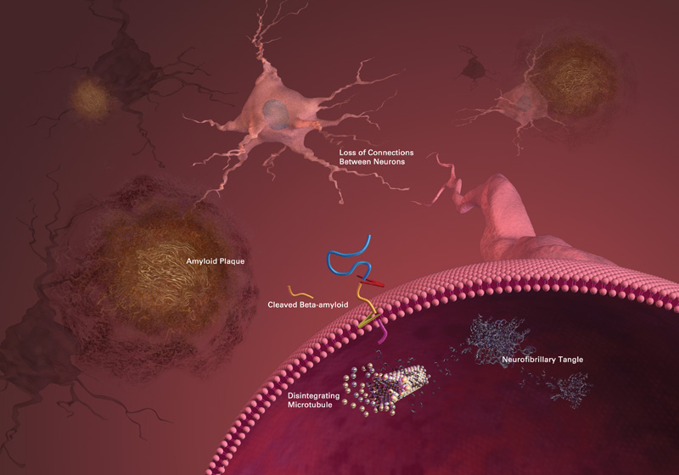
Amyloid plaques and neurofibrillary tangles (NFTs) found in the cerebral cortex
Tangles: Intracellular accumulation of hyperphosphorylated tau strands
Plaques: Extracellular accumulation of insoluble fragments of beta-amyloid (Aβ)
Image courtesy of the National Institute on Aging/National Institutes of Health

Slide 8
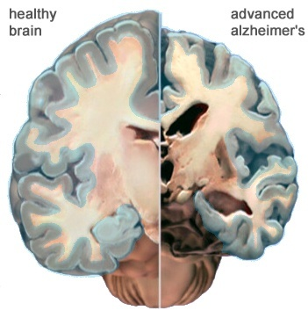
Changes in the brain
ventricles enlarge
Cortex shrivels ,especially near hippocampus
Images courtesy of the National Institute on Aging/National Institutes of Health

Slide 9
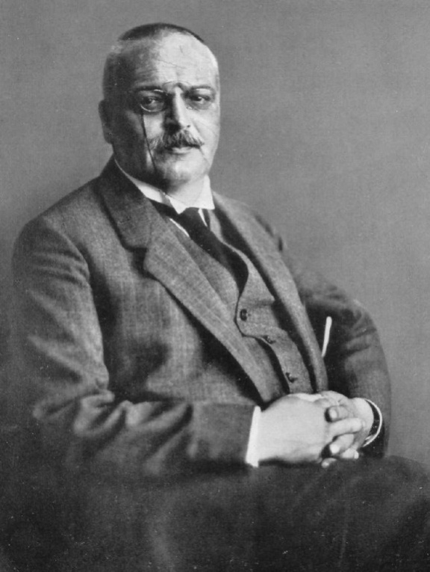
Alzheimer’s Disease
Onset: gradual
Cognitive symptoms: memory impairment core feature with difficulty learning new information, language, visuospatial
Motor symptoms: rare early, apraxia later
Progression: gradual, over 8–10 yr on average
Lab tests: normal
A. Alzheimer

Slide 10
Other common types of dementia
Vascular dementia
“Cue-able” memory loss
Aphasia
Slowed processing
Tremor, gait abnormalities
Stepwise progression
Lewy Body dementia
Falls
Hallucinations
“Spells”
Faster progression than Alzheimer’s
Frontotemporal dementia
Younger onset (40-60)
Behavior change/disinhibition
Language difficulties
Poor judgment and planning
Faster Progression than AD
Mixed

Slide 11
Mild NCD
Mild NCD = MCI
Moderate cognitive dysfunction
Does not impact function
Not attributable to another mental disorder
Acquired not developmental
DSM V

Slide 12
There is no evidence screening for cognitive impairment has any effect on patient, caregiver, or clinician decision making or important patient, caregiver, or societal outcomes.
Ann Intern Med. 2013 Nov 5;159(9):601-12
USPSTF 2013

Slide 14
Benefits of Detection
Early diagnosis of dementia has multiple potential benefits including:
Possible discovery of reversible causes of cognitive impairment
Early use of potential symptom modifying medications
Enrollment in clinical trials for experimental therapies
Avoidance of certain medical regimens that may worsen cognition

Slide 15
Benefits of Detection
Early diagnosis of dementia has multiple potential benefits including:
Possible discovery of reversible causes of cognitive impairment
Early use of potential symptom modifying medications
Enrollment in clinical trials for experimental therapies
Avoidance of certain medical regimens that may worsen cognition

Slide 16
Benefits of Early Detection
Other benefits
Anticipatory planning about future care needs
Personal/public safety issues
Caregiver education and resources

Slide 17
Am J Psychiatry 175:3, March 2018

Slide 18
Barriers to Screening
Provider
Time
Reimbursement
Discomfort

Slide 19
Barriers to Testing
Patient
Fear
“False positives”
Insight
Irritability, decreased “frustration tolerance”
Visual, hearing impairment
Educational level, literacy
Lack of corroboration (lives alone)

Slide 20
When to screen?
Population Health
Individual Health

Slide 21
Medicare Annual Wellness Visit (AWV)
Established in 2010 as part of the Patient Protection and Affordable Care Act
Annual visit that focuses on establishing and maintaining a personalized prevention plan
Medical & family history | Accurate provider & medication List | Self-reported Health Risk Assessment
Detection of cognitive impairment | Depression risk assessment | Functional/Safety assessment
Establishment of a screening schedule (USPSTF) | Establish intervention plan for identified conditions/risk factors | Personalized Health Advice and referral as appropriate

Slide 22
Individual Risk Factors
Patient and/or family report of cognitive decline or decline in function
History of delirium
Patients with multiple risk factors for dementia

Slide 23
Risk Factors for Dementia
Risk Factors
Definite
Age
Family history
APOE4 allele
Down syndrome
Possible
Head trauma
Fewer years of formal education
History of depression
Cardiovascular risk factors (hypertension, diabetes, hypercholesterolemia, obesity)

Slide 24
Detection Tests
Tests
Confusion Assessment Method (CAM)
Mini-Cog
Cognitive assessment is dependent on identifying whether a patient has delirium or dementia

Slide 25
Delirium vs. Dementia
Delirium
Dementia
A sudden change in cognition, characterized by fluctuation, inattention and which can feature disorganized thinking and/or changes in level of activity
May be reversible, if underlying causes identified and treated
Major Neurocognitive Disorder
An often slow, irreversible process results in deficits in memory, problem solving and word finding, severe enough to impact daily function

Slide 26
Time Course is Important
If the changes in thinking/behavior are new (hours to days) they may have delirium
If the changes have been noticed over months to years, they may have dementia

Slide 27
Confusion Assessment Method (CAM)

Slide 28
ANYONE Can Identify Delirium
To perform the CAM, ask yourself:
Acute Onset
Fluctuating Course
Inattention
Disorganized Thinking
Altered Level of Consciousness

Slide 29
Section One
All must be ‘YES’
Acute Onset
Fluctuating Course
Inattention

Slide 30
Testing Attention
5 Digit span forward or 3 backward
Days of the week backwards
Easier with hearing impairment

Slide 31
Section Two
One or both must be ‘YES’
Disorganized Thinking
Altered Level of Consciousness

Slide 32
Disorganized Thinking
If you aren’t sure, you need to test:
Will a stone float on water?
Are there fish in the sea?
Does 1 lb weigh more than 2 lbs?
Can you use a hammer to pound a nail?

Slide 33
Mini-Cog

Slide 34
Mini-Cog
Cognitive impairment screening test for primary care settings
The tool can be administered in three minutes
Does not require any special equipment
Sensitivity reported from 76-99% with specificity from 89-93%
Effectively used in multilingual populations with diverse socioeconomic status and education level
Borson S. et al. Int J of Geriatr Psychiat 2000; 15:1021-1027. Borson S et al. J Am Geriatr Soc 2003; 51:1451-1454. Borson S et al. J Am Geriatr Soc. 2005; 53:871-4. Scanlan JM, Borson S. Int J of Geriatr Psychiat. 2001; 16:216-222.

Slide 35
Mini-Cog
1) Registration
2) Clock draw test
3) Three word recall

Slide 36
Registration
Ask the patient to remember 3 words:
APPLE, TABLE, PENNY
Say each word with a one second pause between them
If they can’t repeat all 3 – say them all again
Repeat them up to 5 times
The patient should not be given any help or cues to remember
Then instruct the patient:
Remember these three words - I will ask you to repeat them later

Slide 37
Clock Draw
Give the patient a pre-drawn circle
Ask them to place the numbers so they “look like the face of a clock”
After the patient has completed placing the numbers, ask them to “draw the hands of the clock so it reads ten after eleven”

Slide 38
Three Word Recall
Ask the patient to recall the three words
Do not give any hints or cues

Slide 39
Scoring
Clock must be correct
All numbers present and in the right sequence
Two hands joining in the center of the clock
Long hand must point to the 2
Short hand pointing to the 11
Patient must get remember all 3 words correctly
http://www.theagepage.co.uk/.a/6a00d83443d1b053ef0176166513f2970c-pi

Slide 40
Scoring
REMEMBER YOU ARE SCREENING NOT DIAGNOSING
Borson et al. Int J. Geriatr Psychiatry 2000

Slide 41
EXERCISE

Slide 42
Thoughts?

Slide 43
CAVEAT
If CAM is positive, it will likely impact the results of the Mini-Cog (or any cognitive testing)
Attention, disorganized thinking
Interpret results with caution

Slide 44
Diagnosis

Slide 45
History
Dementia is still largely a CLINICAL Diagnosis
History
Onset of symptoms
Medical History
Medications
Family History
Substance use or abuse
Social History

Slide 46
Potentially Reversible Causes of Cognitive Decline
D (drugs – anticholinergics, etc)
E (emotional – depression)
M (metabolic – hypothyroid, hypercalcemia, hyponatremia, adrenal disorders, liver failure, renal failure, etc.)
E (ENT – eyes, ears, OSA)
N (neurological other – tumor/mass, NPH, epilepsy)
T (trauma – SDH, ICH)
I (infections & inflammation – encephalitis, vasculitis, lyme, sarcoid)
A (alcohol/anemia – Vitamin B12, folate deficiency

Slide 47
Physical Exam
Examine:
Neurologic status
Mental status
Functional status (direct observation or informant report)
Include:
Office based cognitive testing: SLUMS, MoCA, Folstein’s MMSE
Neuropsychologic testing when presentation is atypical or if results are confounded by a high level of education or subtle changes

Slide 48
Diagnostic Testing
Labs
CBC
CMP
TSH
Vitamin B12
Lyme/Tick Borne
ESR/CRP
Urinalysis
Tox Screen (Heavy Metals)
CSF
RPR/HIV
Neuroimaging
Onset < 65
Sudden or Rapid Progression
Focal neurologic findings
Fall or Head Trauma
Non-contrast CT
MRI
Positron emission tomography (PET)

Slide 49
DIAGNOSIS REPORTING
Fewer than half of people (and their caregivers) with Alzheimer’s have been told of their diagnosis by their health care provider.
Conveying the diagnosis can be associated with distress but not definitively associated with increased suicide risk
Health care professionals have the professional, ethical, and sometimes legal obligation to disclose a diagnosis of dementia

Slide 50
SUMMARY
Dementia screening is common sense
Many benefits to screening, but also potential barriers and harms that need to be considered
Screening ≠ diagnosis
CAM and Mini-Cog both are good screening tools that are easy to administer and have good psychometric properties
Dementia = clinical diagnosis

Slide 51
Questions?

