Slide 1
Driving with Dementia
Goals, Interventions & Assessment
Presented by Heather Shields, OTR/L, CDRS
Owner of Pathways Driving Rehab Services
www.pathwaysrehabservices.com

Slide 2


My background
I am an occupational therapist with over 20 years experience.
I am a driving instructor and certified driving rehab specialist through ADED
I am the owner and creator of Pathways Driving Rehabilitation Services, LLC
I perform driving evaluations and trainings
I offer a unique service, driving rehabilitation, which helps people learn to drive with adaptive equipment, stay driving as long as possible, or determine when it is time to retire from driving.
I provide the only door-to-door mobile driving rehab service in Maine.
I have seen hundreds of people over the past 6 years!

Slide 3
Driving and Dementia-General Considerations
ADED – The Association for Driver Rehabilitation Specialists
Deciding if and when it’s time to stop driving is an extremely difficult and emotional time. When Alzheimer’s or dementia occurs, a decision will need to be made as to when an individual is no longer capable of operating an automobile safely.
The individual’s independence needs to be measured against the potential hazards to themselves and the community.
An evaluation is recommended when a diagnosis or problems first arise.
Compensatory strategies can be used to help maintain safe driving, and to set limits in preparation for the inevitable.
Discussing the issue, and planning for the future, is important to do while the individual has the insight needed to participate.

Slide 4
State of Maine BMV
Dementia guidelines
Many disease processes can cause dementia, most commonly Alzheimer's Dementia, stroke, and Parkinson's Disease.
Less common causes include Lewy Body and fronto-temporal dementias, HIV and other chronic viral CNS infections, B12 deficiency, chronic alcohol damage, and multiple sclerosis. Age 80 years or older
History of a recent crash or moving violations
Applicant self-report or caregiver report of impaired skills
Use of psychoactive medications such as benzodiazepines, neuroleptics, antidepressants, or use of medications for Alzheimer’s Disease
History of active alcohol abuse
istory of falls
Inability to understand or hear instructions during interactions with the health professional
Scores with simple screening tools that indicate the possibility of a cognitive deficit

Slide 5
In Maine, it is the individual’s responsibility to report their medical condition.
Most do not know that
AND if they have dementia, they are less likely to report

Slide 6
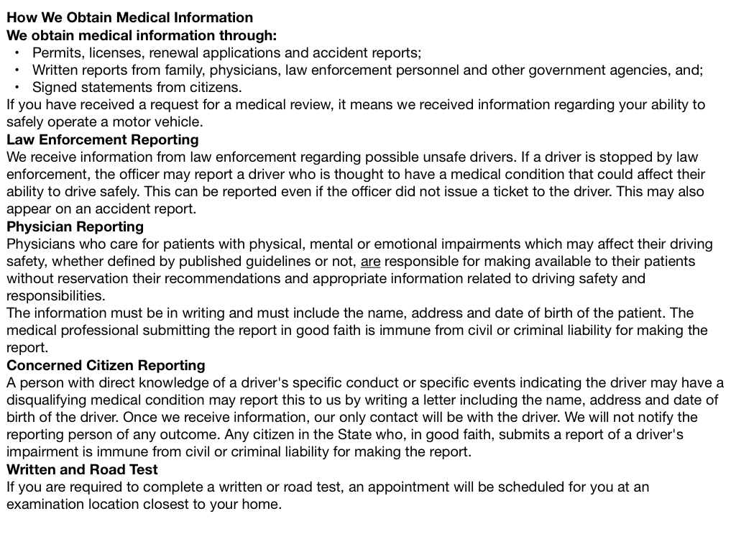

Slide 7
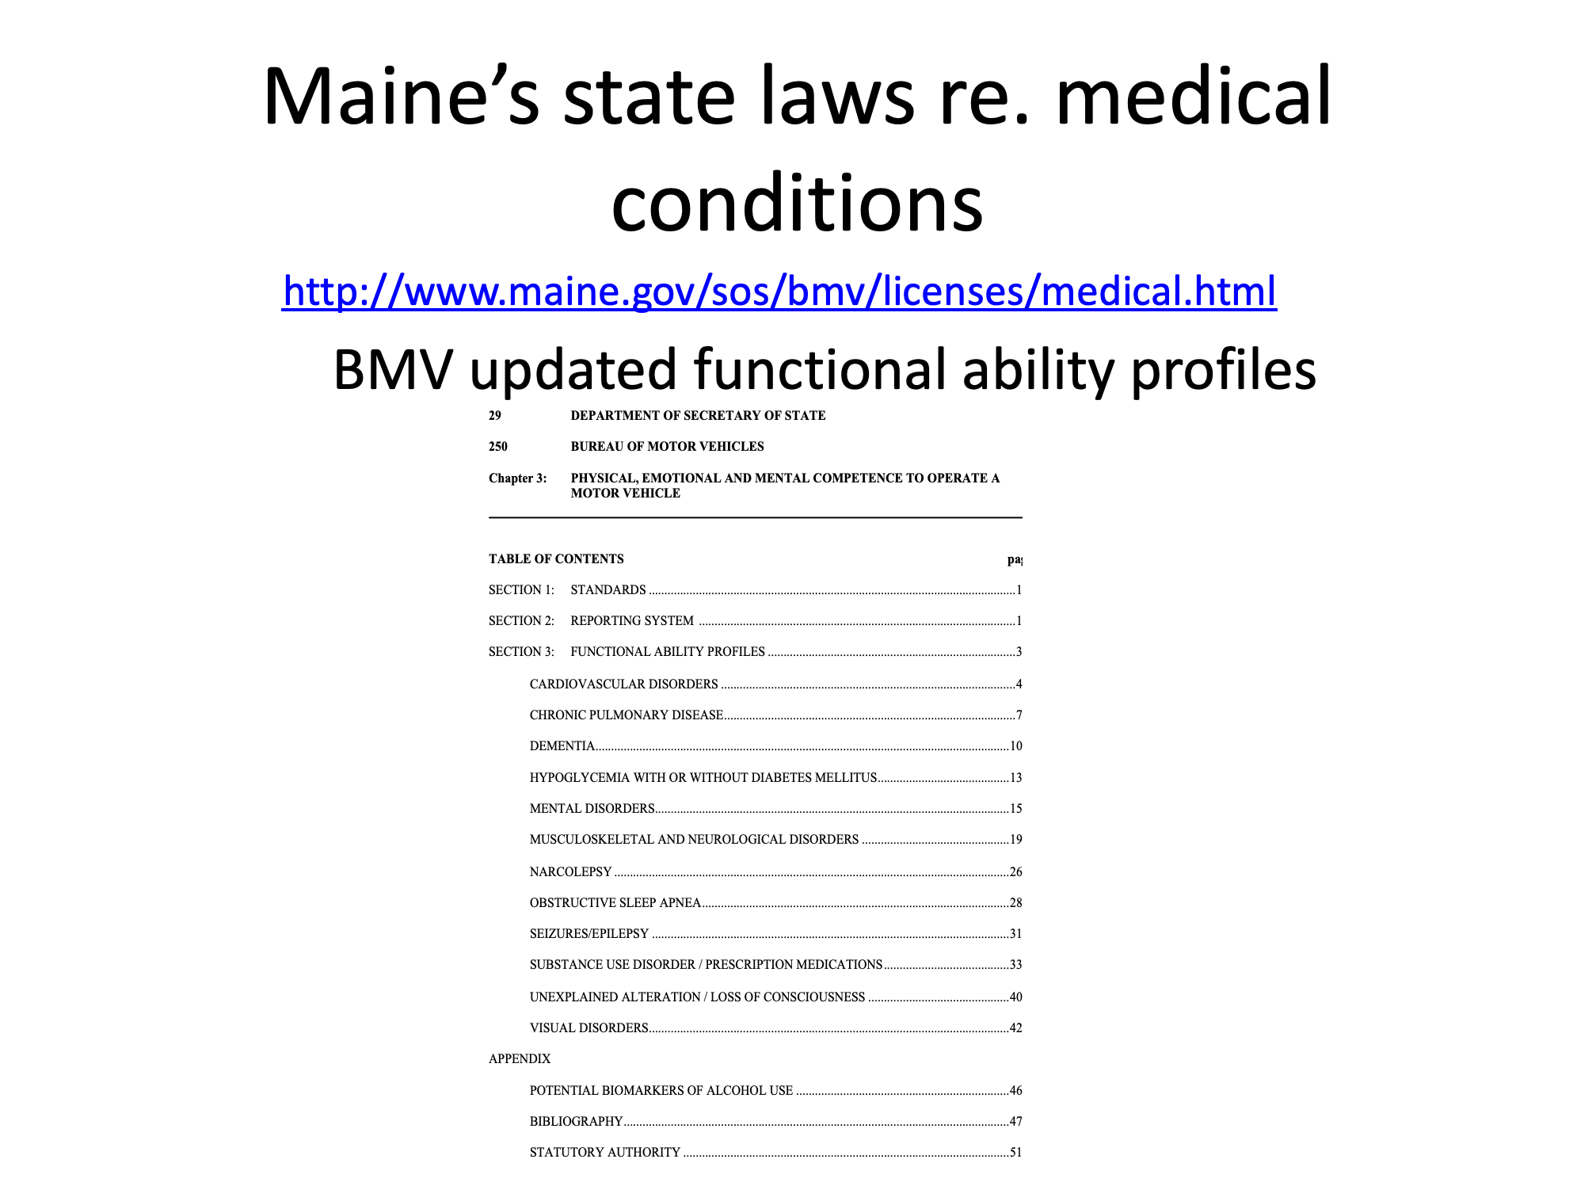

Slide 8
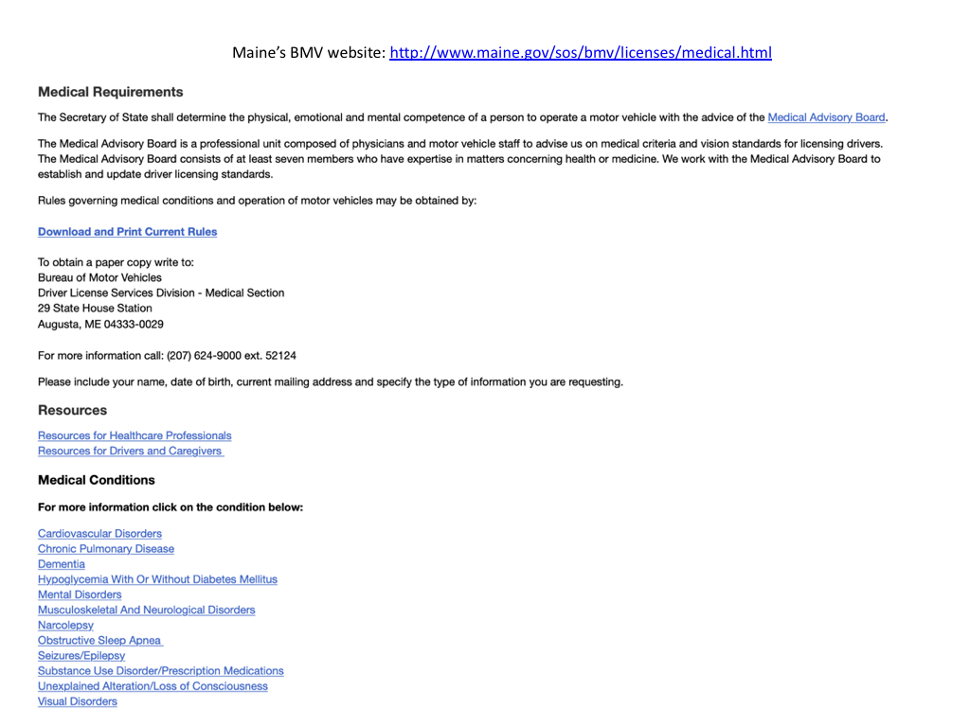

Slide 9
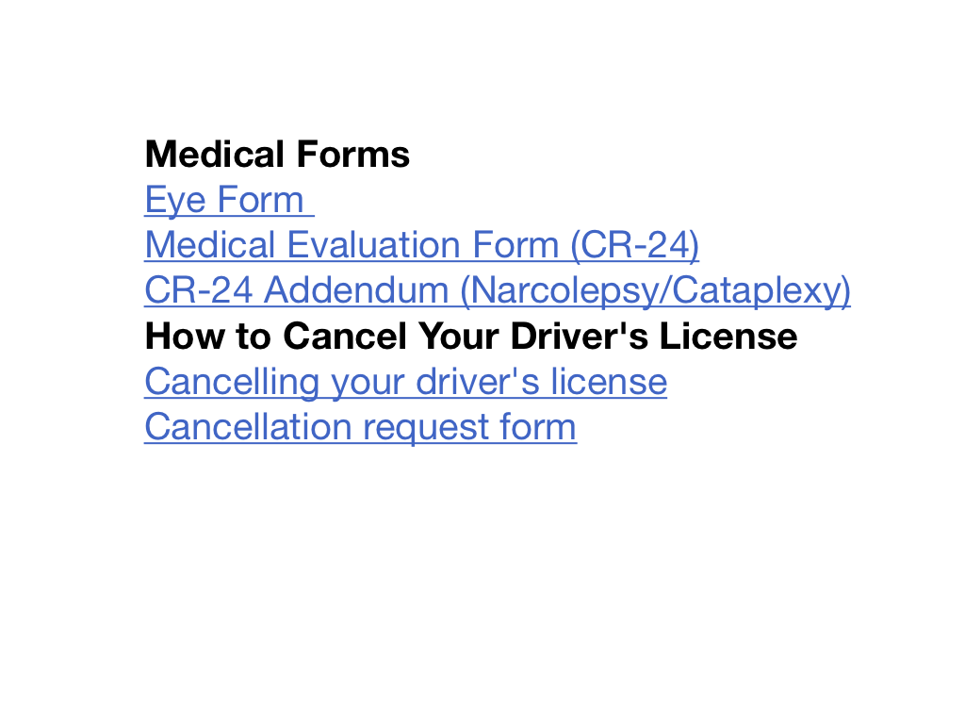

Slide 10
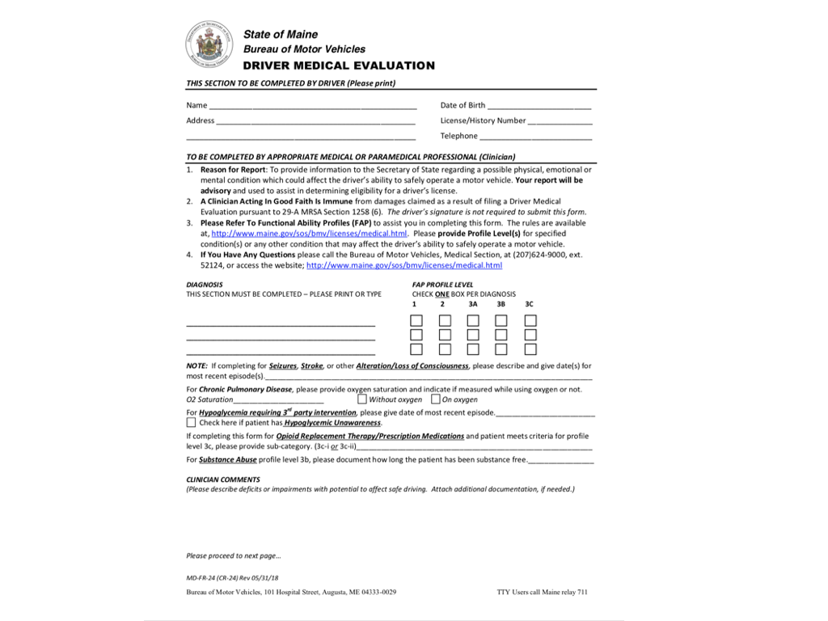

Slide 11
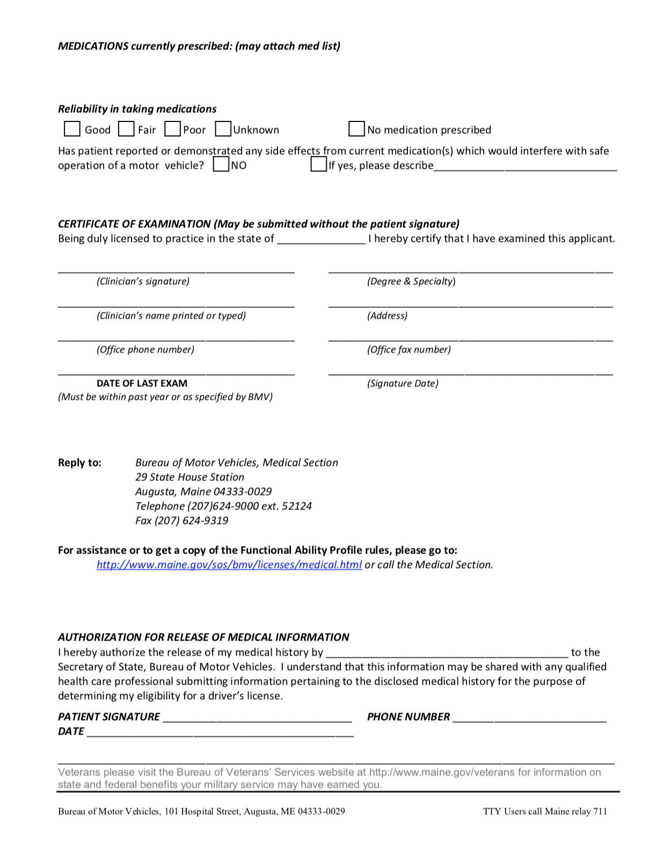

Slide 12
Mild Cognitive Impairment
Maine is no longer performing road tests for this diagnosis.
The person must be formally diagnosed with Dementia in order to prompt a road test.

Slide 13
Where do you begin?
Make driving a routine part of your evaluation and discharge summary
Get the feel for the client’s judgment regarding their medical condition related to driving
Be sensitive and honest when talking about driving
Openly share concerns you have and relate those concerns directly to driving. This gets people’s attention.
Honest communication also builds trust
Give the client specific tasks they can do to improve the skills that are preventing them from driving. They will work on it when it is related to driving.

Slide 14
Interview with patient & family Identify critical changes
Have there been changes in daily routines in the past 6 months?
Medication management
Financial management
Organizational skills
Interests
Activity levels
History of falls

Slide 15

Changes in driving patterns
Positive self limiting driving patterns:
No longer drives at night or in busy traffic, asks someone to drive them to Portland
They are now taking routes offering more protection with lights or avoiding left hand turns

Slide 16
We are always making observations
•Your assessment begins the minute you meet the client and their family.
•The client really focuses on wanting to drive, but demonstrates decreased insight.
•Is the partner answering all the questions?
•Is the client using good judgment?
•Be observant and it will help you put together a picture right away.
•Listen to your instinct. It will never lead you astray.
•When you have concerns, you need to further assess and treat the concerns.

Slide 17
Pre-driving skills necessary to consider
Physical and motor control
Sensation
Vision and perception
Cognitive skills
Communication skills receptive or expressive aphasia, interpreting unspoken language.

Slide 18
Physical and motor control
•ROM
•Strength
•Timing and coordination of movement
•Speed and fluidity of movement
•Reaction to their surroundings, particularly busy environments
•Smooth motor control and Motor planning

Slide 19
Cognitive and executive functioning
•Can they multi task?
•Do they need a quiet environment to focus?
•Can they perform high level cognitive tasks with background noise?
•Do they manage their medications independently, if not why?

Slide 20
•General orientation
•Memory short term and long term
•Initiation
•Attention: selective attention, divided attention
•Problem solving
•Planning, sequencing, anticipation
•Processing speed, reaction time
•Decision making
•Flexibility in thinking
•Impulsivity
•Interpretation and reaction to stimuli
•Judgment
•Self awareness
•Insight
•Ability to predict

Slide 21
Vision and Perception
Acuity
Hemianopsia
Field cut
Visual midline shift
Visual field
Peripheral vision
Contrast sensitivity
•Visual neglect
•Progressive visual conditions
•Pathfinding
•Visual scanning
•Visual processing

Slide 22
General Sequence I follow
Perform screens: MOCA, MMS, Short Blessed test, etc.
Compare screening results to functional outcomes
When there are impairments on paper and functionally, then perform treatment sessions to help overcome those impairments.
Educate the client and family about their impairments, the cause for them and how to overcome the impairments.
Link the impairments to driving.

Slide 23
Screening tools guide our treatments
•Remember that the paper tests are only screening tools.
•Use the screening tools to identify problem areas, then use functional situations to confirm those impairments.

Slide 24
Common tests used by OT’s across the country
•Draw a Clock
•Short Blessed
•MOCA
•CLQT maze and design generation
•Trails A and B(a big correlation with on-the-road performance)
•Recognition and interpretation of signs
•Dynavision
•Stereo-Optec
•Visual attention and neglect tests
•MVPT
•Developmental Test of Visual Perception, 2nd Edition (DVPT-2)

Slide 25
Common online tools
•Driver Performance Test https://www.youtube.com/watch?v=vpM6SKVc_kA
•The Fitness to Drive Screening, a web-based tool ready for use by caregivers and/or family members of older drivers and Occupational Therapy practitioners to detect older drivers at risk. http://www.aota.org/Practice/Productive-Aging/Driving/Practitioners/Screen/FTDS.aspx
•AAA Roadwise Review: A tool to help seniors drive safely longer http://www.roadwiseonline.org/#GSMMSplash
•Drive Focus www.drivefocus.com
•Adolescent Skills Check list the link to the PDF is in Everlesson
•The Enhanced Driving Decisions Workbook http://www.um-saferdriving.org/firstPage.php

Slide 26
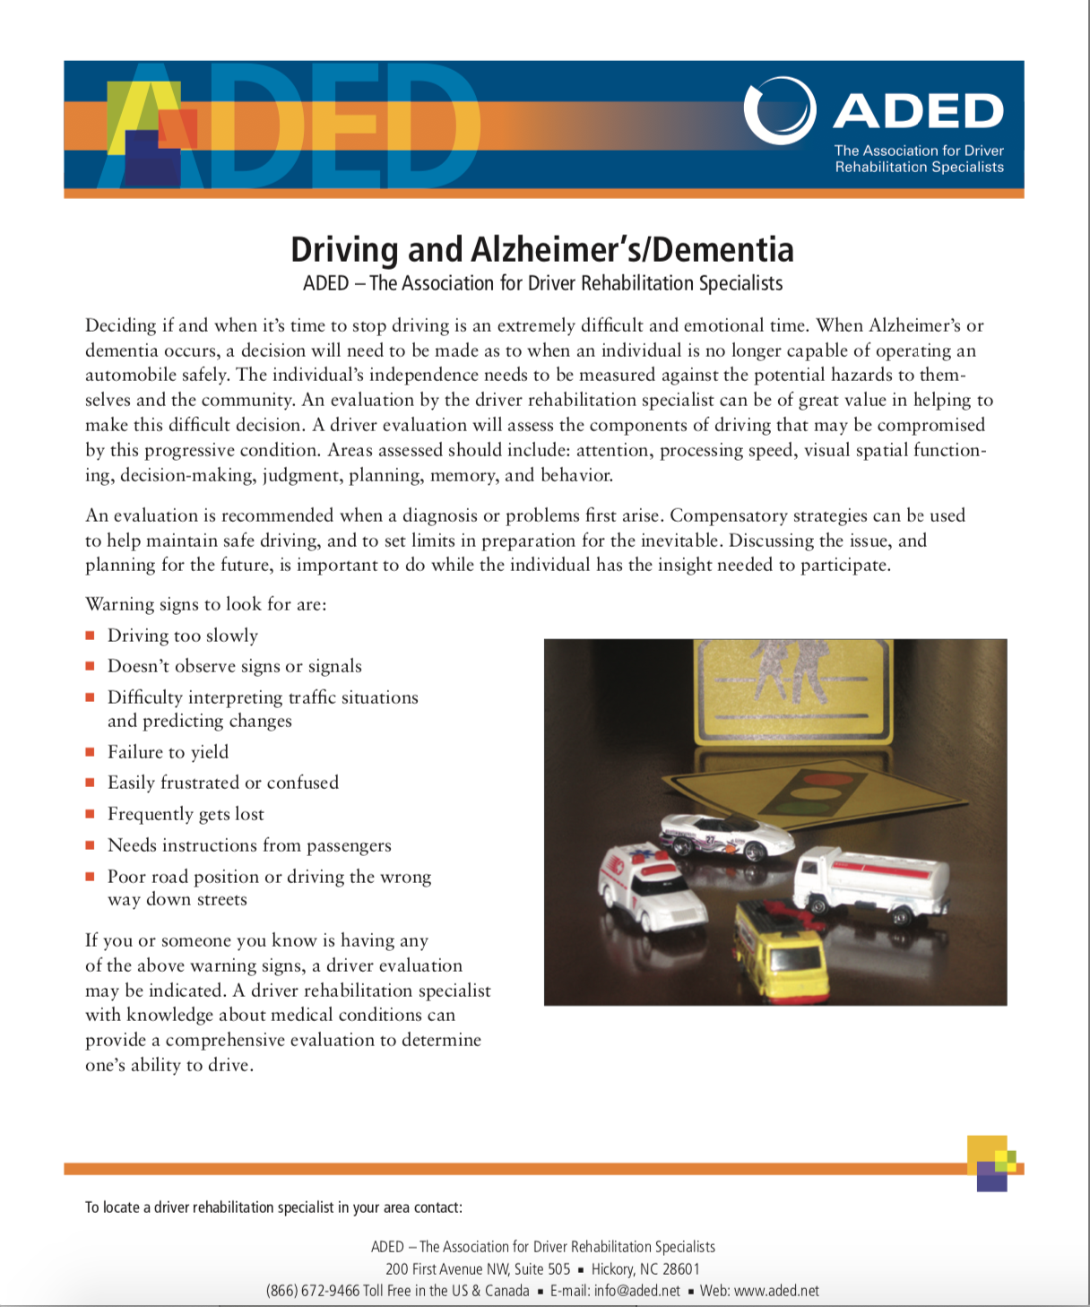

Slide 27
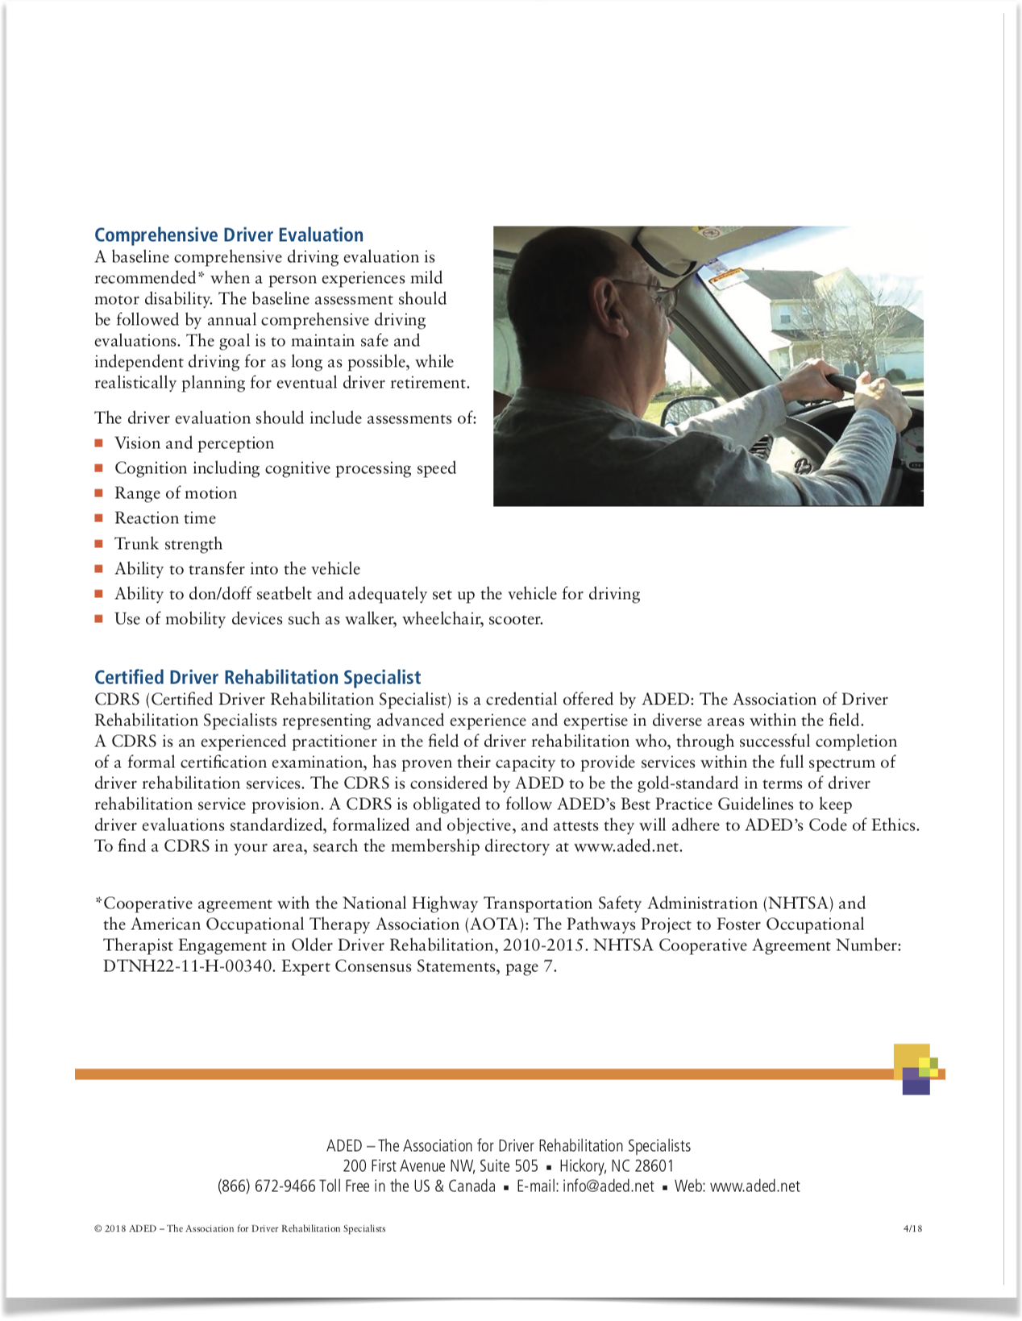

Slide 28
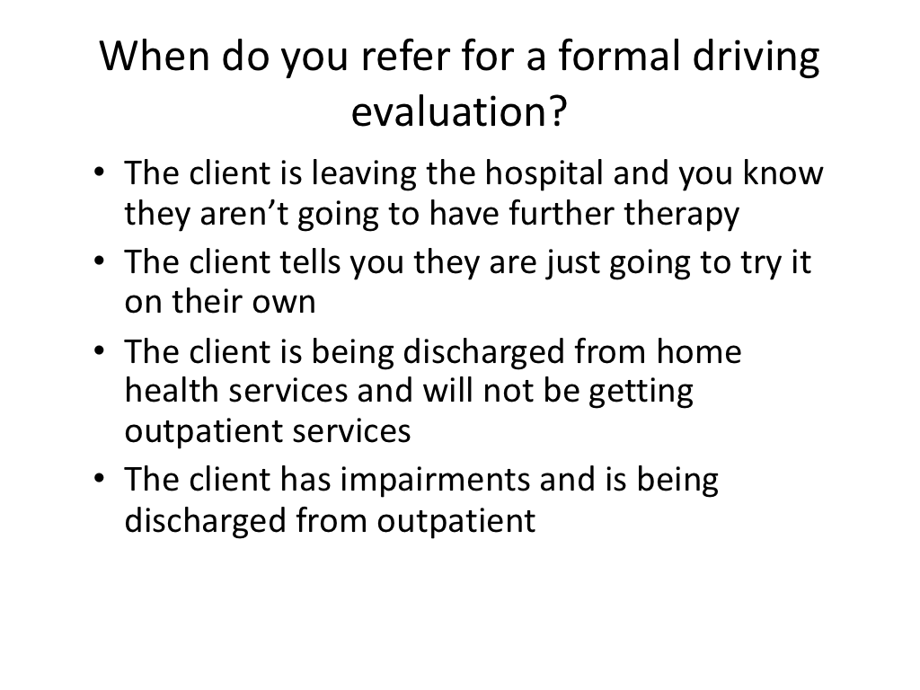

Slide 29
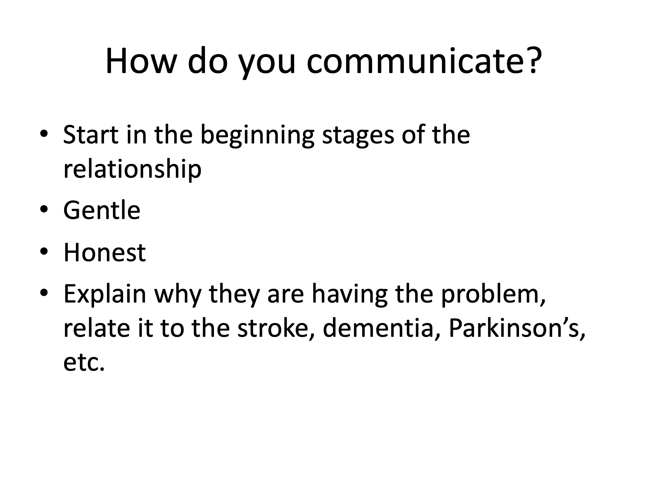

Slide 30
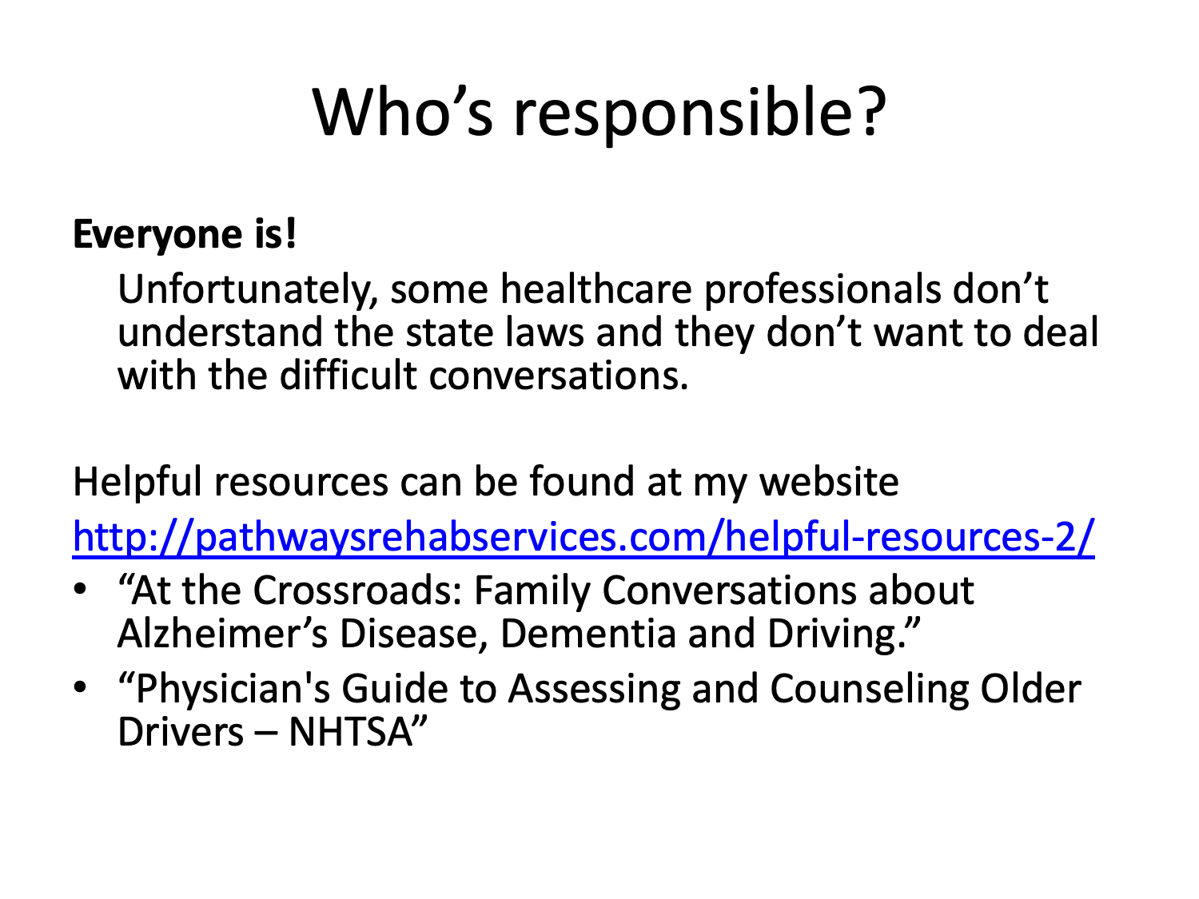

Slide 31
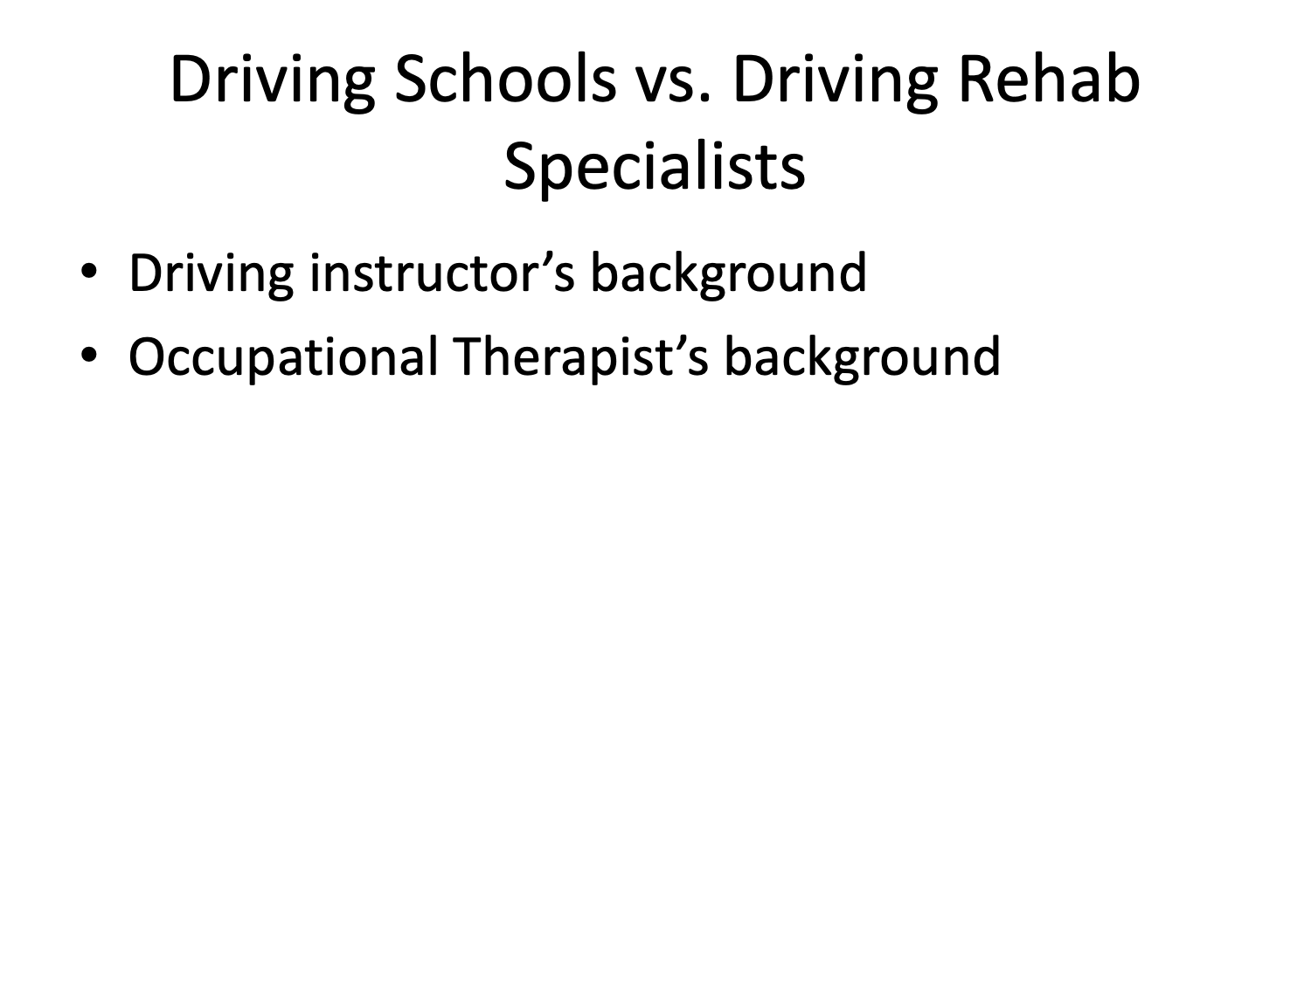

Slide 32

Pathways is here to help you!
Call to learn more about how I can help you!
207-530-0307
To fax a referral, send the most recent progress note and face sheet so that I can initiate contact with the patient
207-512-1044
www.pathwaysrehabservices.com

