Slide 1
Maine’s 2012 State Plan for Dementia & The Healthy Brain Initiative Laurie Bowie, Executive Director, Alzheimer’s Association, Maine Chapter

Slide 2
Mission
To eliminate Alzheimer’s disease through the advancement of research; to provide and enhance care and support for all affected; and to reduce the risk of dementia through the promotion of brain health.

Slide 3
Vision
A world without Alzheimer’s disease®.

Slide 6
State Plan for Alzheimer’s Disease and Related Dementias in Maine
Public Awareness and Public Health & Safety
Diagnosis & Treatment
Home & Community Based Services
Facility-Based Long-Term Care Services
Financing Long-Term Care Services
Education & Training

Slide 7
Proposed State Legislation
LD 511 An Act To Create an Alzheimer's Disease and Dementia Coordinator Position within the Department of Health and Human Services
LD 455: An Act To Authorize a General Fund Bond Issue To Expand Maine's Research, Development, Commercialization and Clinical Infrastructure Assets To Improve Outcomes for Maine Families with Members Suffering from Alzheimer's, Dementia and Other Diseases of Aging

Slide 8
Originating Partners
Centers for Disease Control and Prevention
Alzheimer’s Association
Purpose
Advance cognitive health as an central part of public health practice
Notes:
At ALZ we recognized demographic trends with aging, age being the greatest risk factor for Alzheimers, necessitated a public health response, so we established the HBI in 2005 with CDC to advance cognitive health as a central part of public health practice.

Slide 9
Key Decisions
Focus on state and local public health agencies
Collaborating partners = aging, health care, academia, and other sectors
Adopt a life-course perspective
Reduce actions, but elevate impact
Emphasize policies, systems, and environments
Integrate dementia caregiving and generating evidence for action
Heighten attention on health disparities
Notes:
Early in the process, the Leadership Committee affirmed the 2nd Road Map’s focus on state and local public health agencies
But decided to strengthen the call for partnerships with the aging and disability network, health systems, and research
We kept the Essential Services of Public Health as an organizing framework
Based on feedback on the 2nd RM, the Committee found ways to reduce the number of actions from 35 to 25. Some of the simpler actions were removed. The leaders also recognized a need to provide more guidance on dementia caregiving and generating data to inform policies and practices.
The resulting set has a greater emphasis on changing policies, systems, and environments, which is a hallmark strength of public health. It also strongly emphasizes the need to prioritize populations with health disparities.

Slide 10
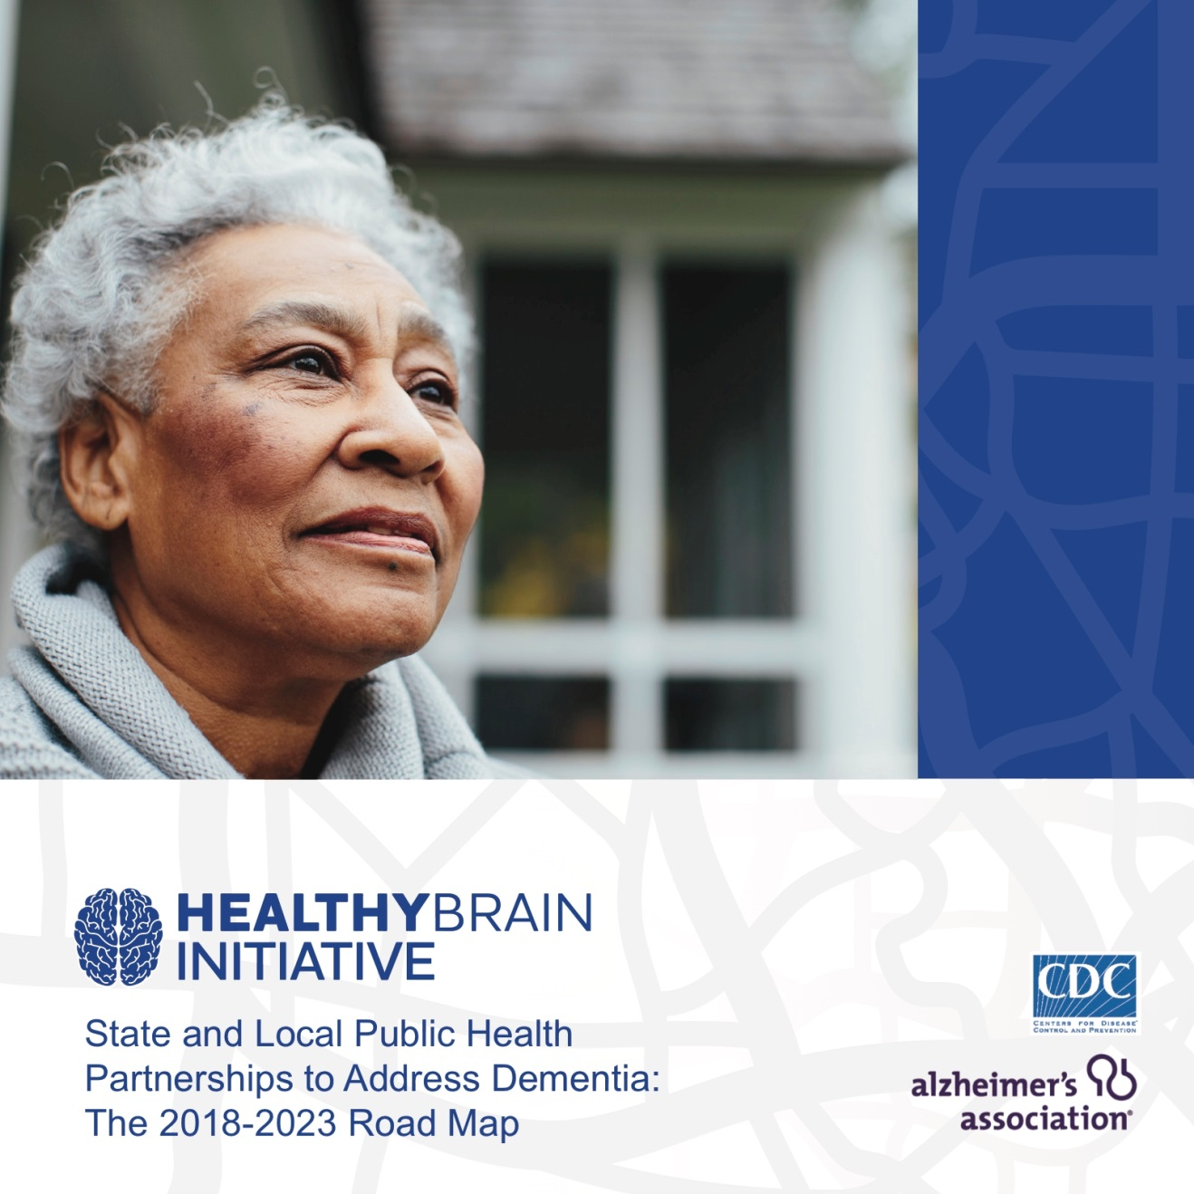
Notes:
Voila! …the next Road Map.
The goals are to catalyze the public health sector to
reduce the burden of dementia,
improve health outcomes, and
promote health and well-being among both people living with dementia and their caregivers.

Slide 11
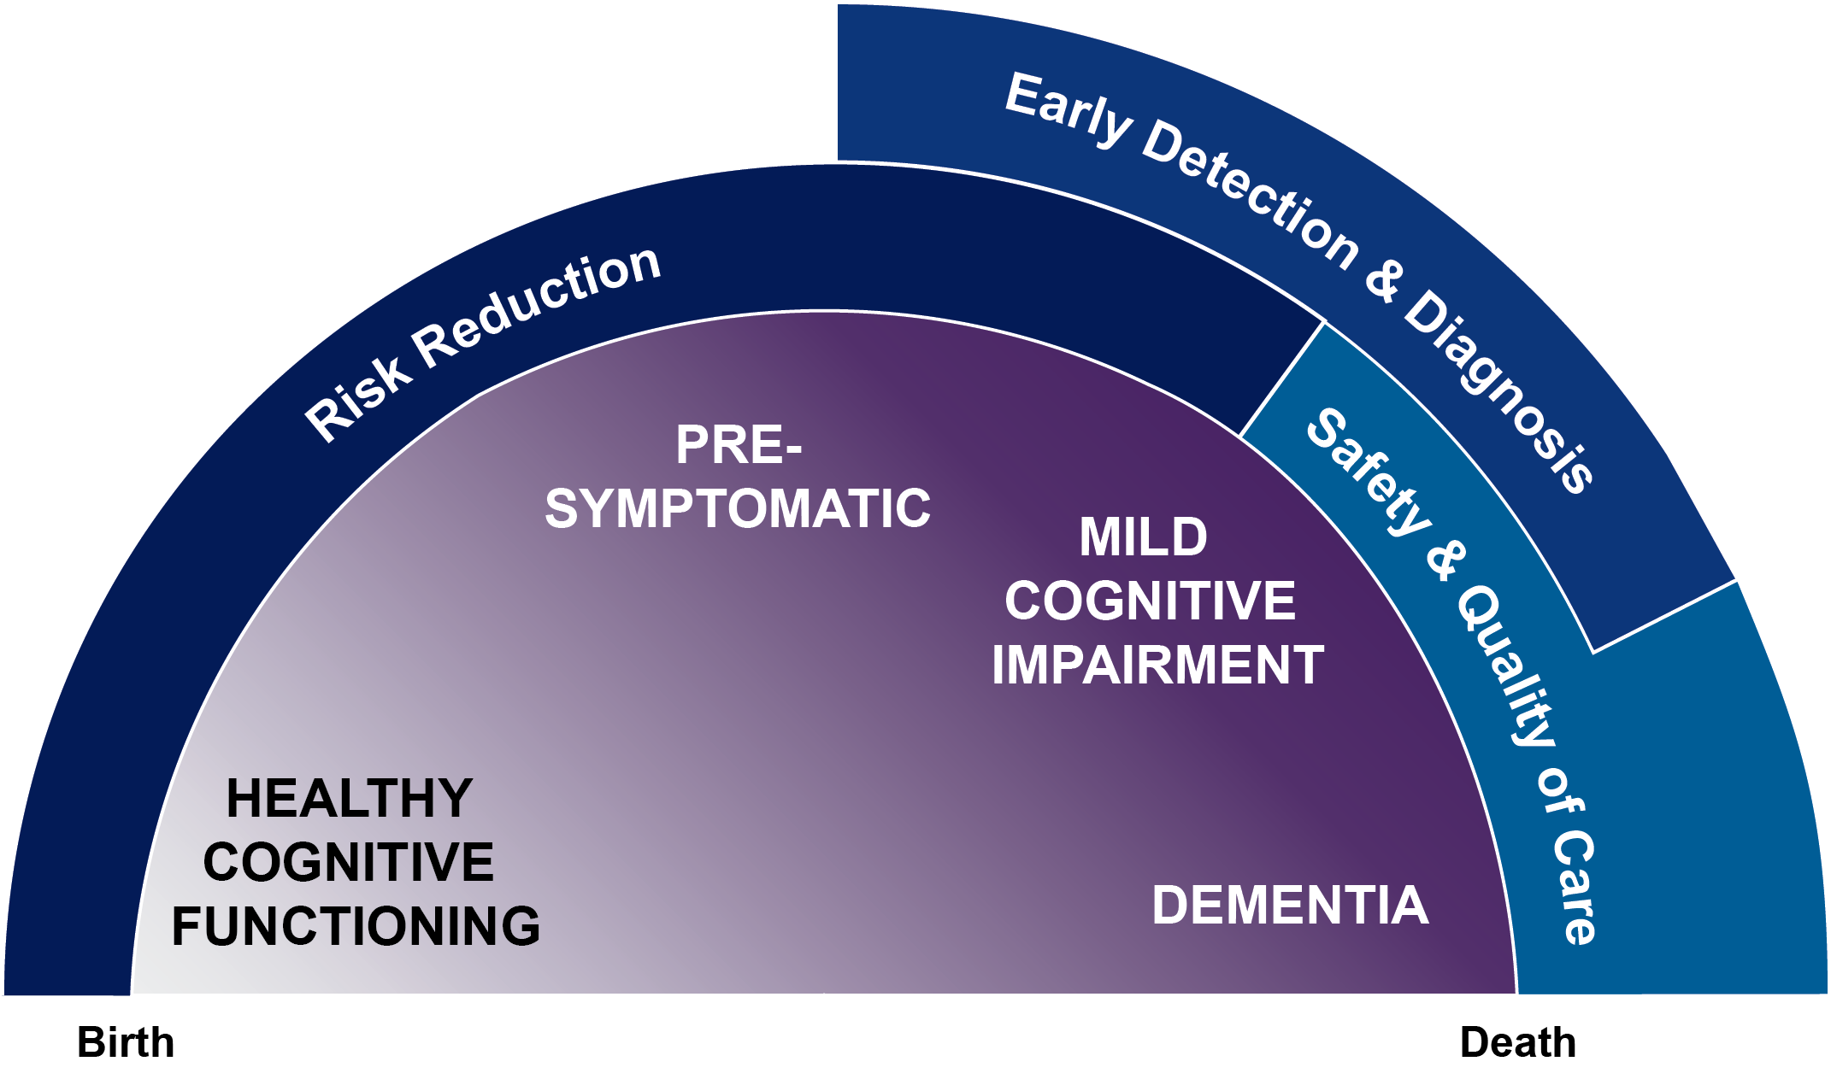
Life-Course Perspective and Public Health Roles
Notes:
Today we understand that the brain changes associated with Alzheimer’s and other dementias take root many years, even decades, before symptoms appear. That is why a life-course approach to Alz and other dementias is needed, and why we need public health involvement. Because public health is actively promoting health at all ages and stages of life.
Throughout the dementia continuum (purple), the public health community (blue) can intervene by promoting health behaviors to reduce risk of cognitive decline, encourage early detections and diagnosis of cognitive impairment and dementia, ensure the safety of those with memory issues, and improve the quality of care for people impacted by dementia in their communities.

Slide 12
Core Issues
Risk identification and risk reduction
Early detection and diagnosis, and quality of care
Dementia caregiving
Education and training for professionals
Data and evidence for action
Notes:
That (previous slide) is why the course of Alzheimer’s should be viewed as a continuum across the lifespan.
In this context, new Road Map actions center on 5 key opportunities for public health agencies to apply their broad, community-based approaches to:
>> bullets

Slide 13
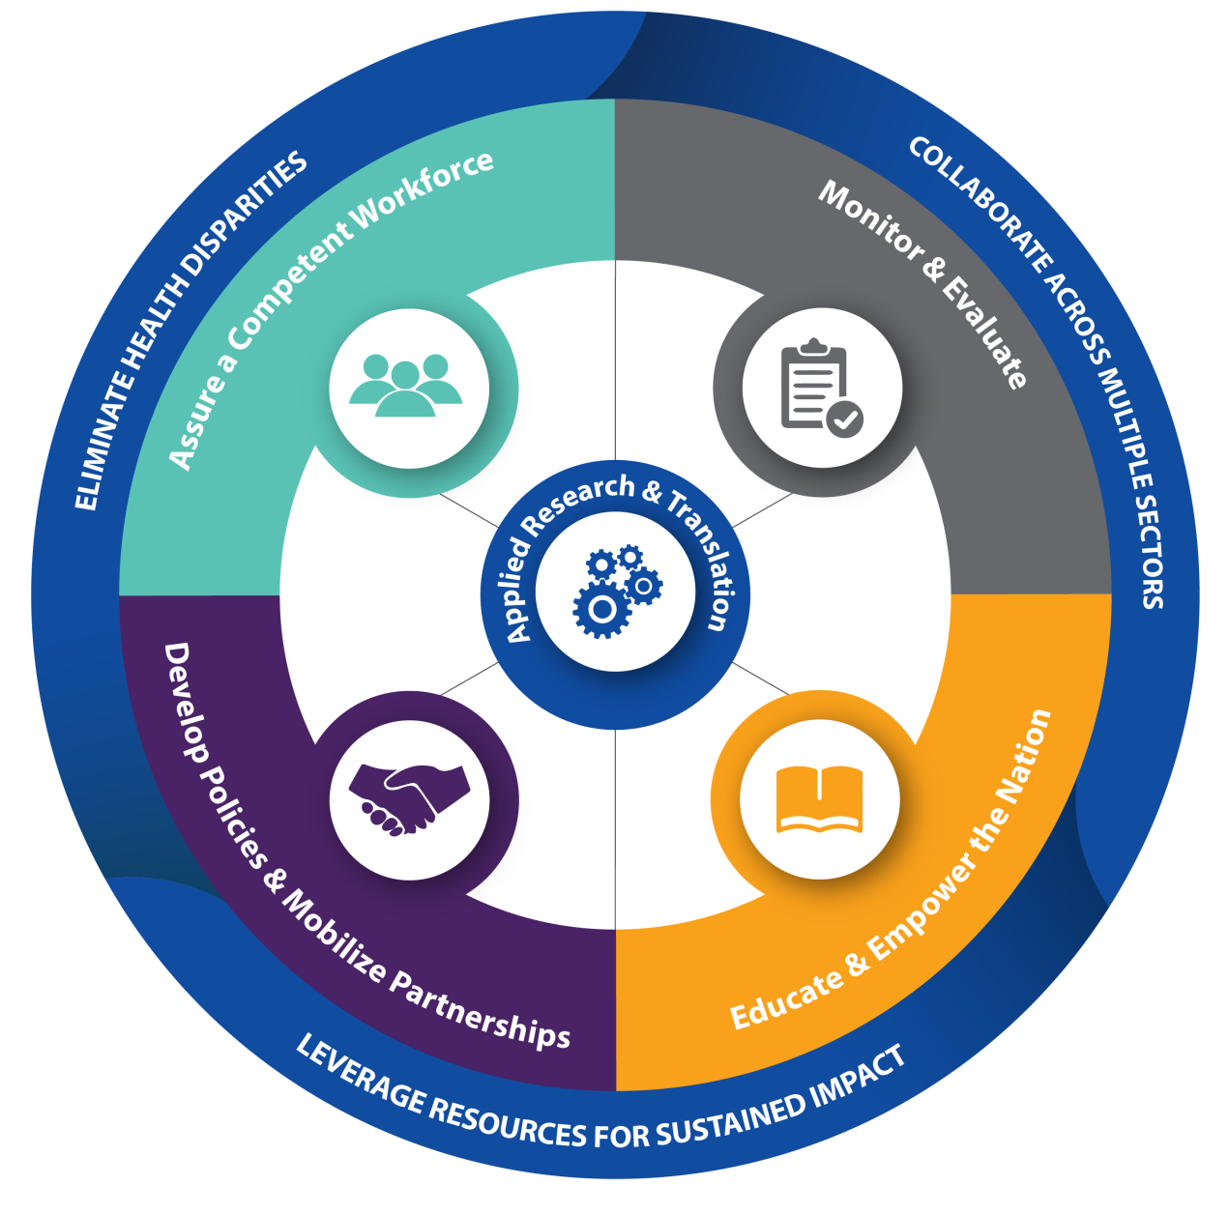
Framework: Essential Services of Public Health
Notes:
The Road Map is organized by four Essential Services of Public Health
Assure a competent workforce
Monitor and evaluate
Develop policies and mobilize partnerships
Educate and empower communities
Actions within each of these four domains is guided by three core principles to best reduce health disparities, collaborate across multiple sectors, and leverage resources for sustained impact.
In the center, applied research and translation is needed to move science from bench to trench to widespread adoption of effective interventions

Slide 14
Priority Actions
Educate the public about talking to health professionals about memory problems. (E-1)
Build public knowledge about brain health across the life span. (E-2)
Increase public awareness about the role of caregivers and their health needs. (E-3)
Expand people’s use of interventions that enhance health, wellbeing, and independence. (E-7)
Notes:
All 25 of the actions are important. But we often get asked, how do I start?
With [CDC/ALZ], we are calling out 12 actions as particularly feasible and relevant in this moment. (These are not listen in any particular order.)
>>

Slide 15
Priority Actions
Integrate effective interventions and best practices into policies and practices. (P-1)
Educate policy makers about cognitive health and impairment and the role of public health. (P-3)

Slide 16
Priority Actions
Prepare public health and healthcare professionals to inform people about brain health. (W-1)
Inform public health professionals about their role in addressing dementia. (W-3)
Educate healthcare professionals about their role in addressing dementia. (W-4)

Slide 17
Priority Actions
Implement the Behavioral Risk Factor Surveillance System (BRFSS) modules for Cognitive Decline and Caregiving. (M-1)
Use data to inform public health programs and policies. (M-3)

Slide 18
What You Can Do – Public Health
Public Health Organizations
Raise awareness
Educate your members, constituents
State and Local Public Health
Review Road Map
Prioritize and implement actions
Evaluate
Share your successes
Notes:
National public health organizations are asked to help raise awareness of the new Road Map and make sure their members or professional constituents know about it.
State and local public health leaders should read the Road Map and prioritize actions that fit with local goals. Evaluating that work is essential, and because everyone is in the learning mode, be sure to share successes with other public health leaders.

Slide 19
What You Can Do – Other Partners
As appropriate:
Promote the Road Map
Inform policy makers
Integrate into existing community benefit and other plans
Collaborate on implementation
Conduct applied research and translation

Slide 20
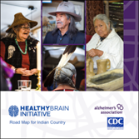
Road Map for Indian Country
American Indians and Alaska Natives: gains in longevity, but elders with higher risks for dementia and heart disease
Tailored for tribal and Native health leaders to engage their communities on Alzheimer’s and other dementias
Suggest public health responses to
Reduce risk for cognitive decline
Advance early detection
Support caregivers
Monitor and evaluate
Notes:
With significant input from AI/AN leaders and health experts, CDC and the Alz Asso released in May 2019 the first-ever HBI Road Map for Indian Country. It is offered as a tool that AI.AN leaders can use to help their communities reflect on the effects of dementia on elders, their families, and other parts of the community. Suggests public health strategies that can be adapted to local priorities. It also provide examples of tribal and Native community responses. CDC and the Association of State and Territorial Health Officials have produced a set of health communications resources for AI/AN health leaders regarding the brain health-heart health connection.

Slide 21
Building Our Largest Dementia (BOLD) Infrastructure for Alzheimer’s Act (P.L. 115-406)

Slide 22
3 Components of BOLD
Establishes Alzheimer’s Centers of Excellence
Provides funding for
public health departments across the country
Increases data analysis and
timely reporting

Slide 23
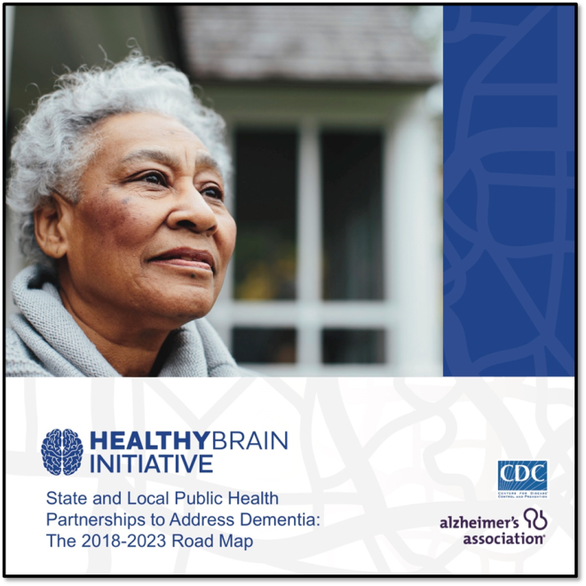
Take-Aways
Alzheimer’s and other dementias are costly, are growing, and affect millions of people
Public health community must act now to stimulate strategic changes in policy, systems, and environments
New Road Map will help public health and its partners chart a course for a dementia-prepared future

Slide 24
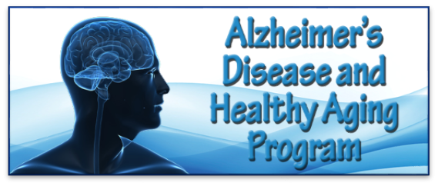
For More Information
Centers for Disease Control and Prevention (CDC)
Alzheimer’s Disease + Healthy Aging Program
cdc.gov/aging
Alzheimer’s Association
Public Health Department
alz.org/publichealth
Maine Chapter lbowie@alz.org 207-772-0115

