Slide 1
Mild Cognitive Impairment: Is Dementia Inevitable?
Cliff Singer MD
Chief of Geriatric Neuropsychiatry
Principal Investigator, Alzheimer’s Disease Research
Northern Light Acadia Hospital and EMMC Clinical Research Center
Adjunct Professor, University of Mainee goes here Calibri 16pt bold charcoal up to two lines

Slide 2

Acadia’s Geriatric Program
Mood and Memory Clinic
Alzheimer’s Disease Research Program

Slide 4
What’s Normal.
What’s his name?
What’s that called?
Where did I park?
Where did I put those?
Did I tell you this already? Yes.
Did I ask this already? Yes.
Did you tell me this already? Yes.

Slide 5
What’s not normal.
Getting lost in a familiar place.
Not being able to follow a directions/recipe
Telling the same story more than twice without asking.
Asking the same question more than twice.
Losing interest in conversation, leaving home, hygiene, other people

Slide 6
Cognitive Changes Salthouse TA. Current Direct Psychol Sci 2004; 13:4:140-44

Slide 7
Natural History of Cognitive Change
Normal Aging
MCI
Dementia
Noticeable symptoms
Diagnosis
Time

Slide 8
Memory: Age Effects
 | Description | Age effects
Working memory | information for rapid access | moderate decrease
Remote memory
-implicit | instinct | increases
-procedural | know-how | increases
-autobiographical | personal knowledge | preserved
-semantic | general knowledge | increases
Recent memory
-episodic | Events, conversations | greatest decline
-prospective | remember to do something | decreases

Slide 9
Progression of Cognitive Changes
 | Aging | MCI | Dementia
Recall and learning | Intact | Impaired | Impaired
Executive | Intact | Intact | Dependent
Reasoning | Abstract | Abstract | Concrete
Navigation | Intact | Transition | Impaired
Speech | Mild WFD | Transition | Anomia
Behavior | Normal | Changing | Changed

Slide 10
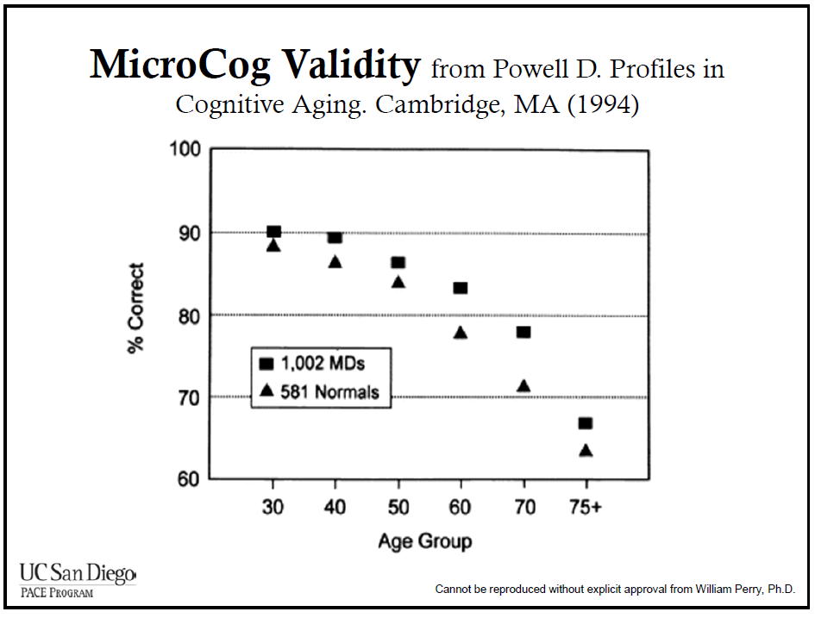
Advantage of High Education Fades >70 Due to Incidence of AD/MCI

Slide 11
Mild Cognitive Impairment: A Concept in Evolution Peterson RC et al. J Int Med 2014
AKA Mild Neurocognitive Disorder in DSM 5
Measurable decline in memory and/or executive cognitive function from baseline (lowest 1.5 SD for age)
Originally viewed as transition phase to AD dementia, now seen as more heterogenous (“prodromal AD”)
Prevalence is age, sex and criteria dependent
Average prevalence is 18.9%
Amnestic subtype shows independent in daily functioning (w/caveats) and essentially preserved general cognitive function but:
At higher risk for financial scams, medication errors, traffic accidents, psychiatric symptoms (mild behavioral impairment)

Slide 12
Mild Cognitive Impairment
Subjective memory complaint
Normal ADLs, softening competence in IADLs
Normal general cognition and transitional scores on tests
MMSE 24-27; MoCA 18-26
Amnestic subtype (single domain):
Abnormal memory for age (lowest 10%)
Often pre-dementia Alzheimer’s Disease
Conversion rate to dementia as high as 12-15% per year vs. 1-2% for those w/normal recall, but clinical course is highly variable and AD can be multidomain
“Non-amnestic” forms possible prodrome to other types of dementia, but AD may present this way too

Slide 13
“Non-amnestic” MCI
Primarily executive-cognitive impairment but not severe enough to prevent independent function
Can represent non-AD conditions that might progress to dementia: small vessel vascular disease, stroke, Parkinson’s spectrum, depression, schizophrenia, sleep disorders, TBI, etc.
More variable course than prodromal amnestic MCI due to AD

Slide 14
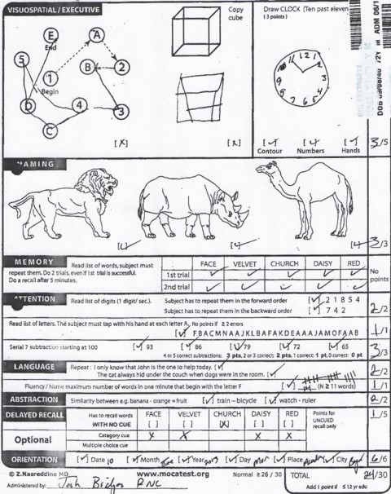

Slide 15


Slide 16
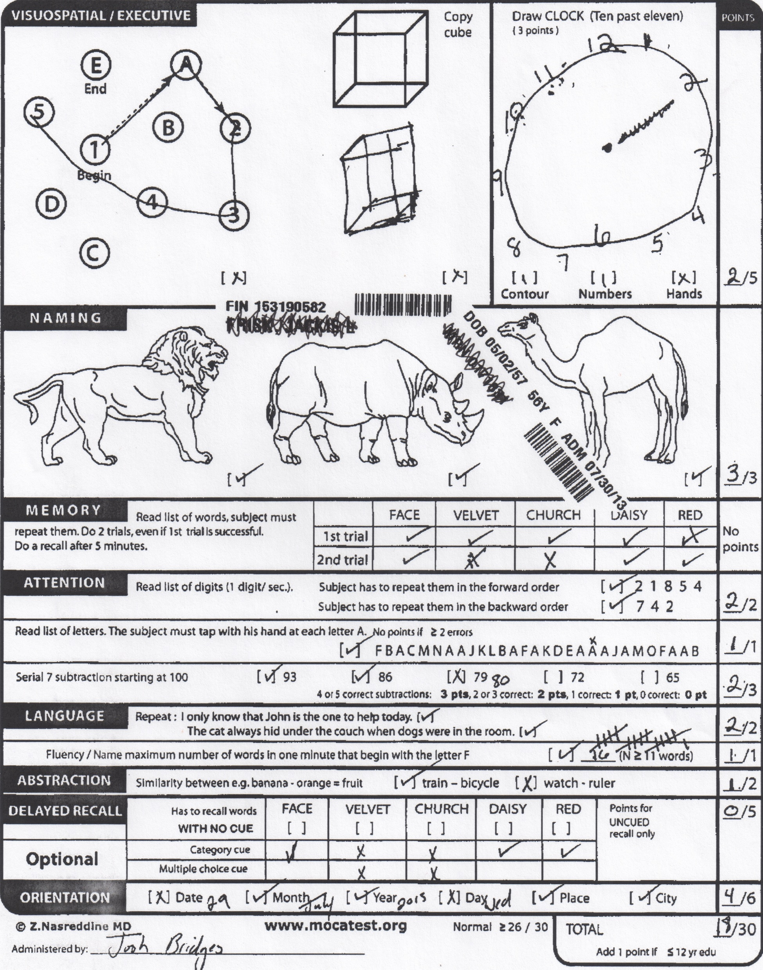

Slide 17
Neuropsychological Criteria for MCI Bondi MW et al. J Alzeimer’s Dis 2014

Slide 18
Sex-Specific Norms for Verbal Memory Tests Improves Diagnostic Accuracy of Amnestic MCI Sundermann EE et al. Neurology 2019
20% error rate found when using standard diagnostic criteria because of higher verbal skills in women (e.g. more false negatives)

Slide 19
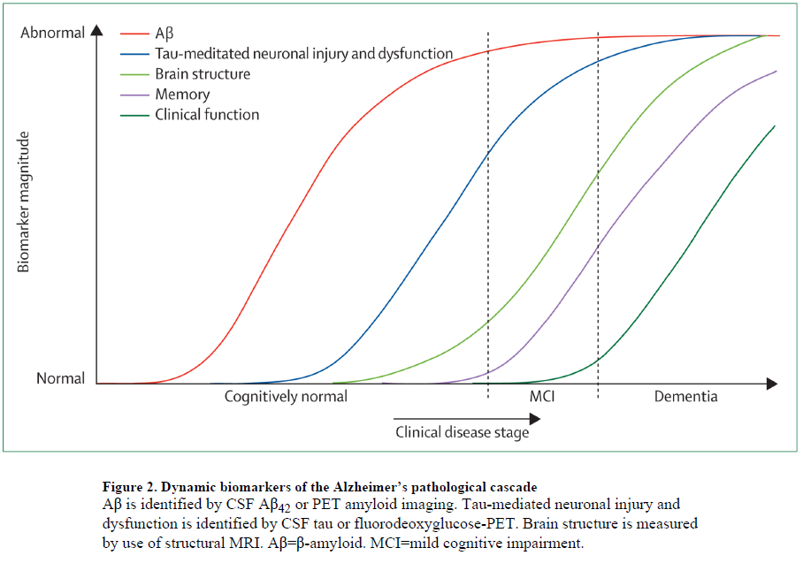
Hypothetical Progression of AD Jack CR et al. Lancet Neurology 2010

Slide 20
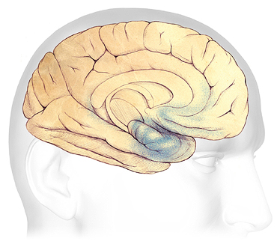
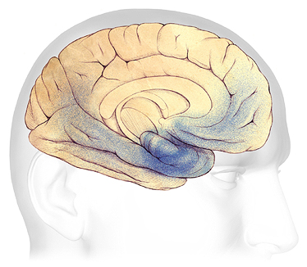
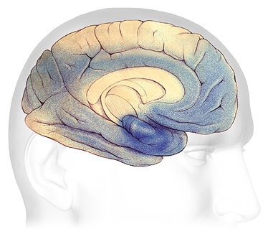
MCI from AD
Moderate-severe dementia
Mild Dementia

Slide 21
Frequency of Different Types of Dementia Slot R et al. Alzheimer’s & Dementia 2019

Slide 22
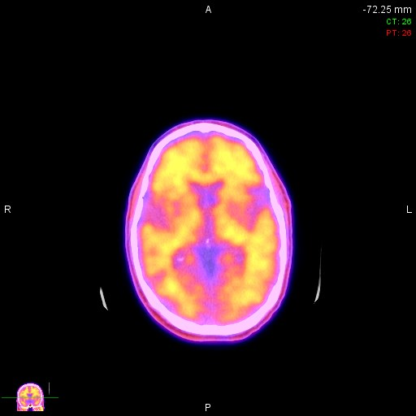
Positive β amyloid PET Scan
Strong signal at the edges indicating binding of amyloid ligand to cortical gray matter; can be seen years before MCI or dementia
Therapies targeting amyloid at MCI stage have been futile almost without exception.

Slide 23
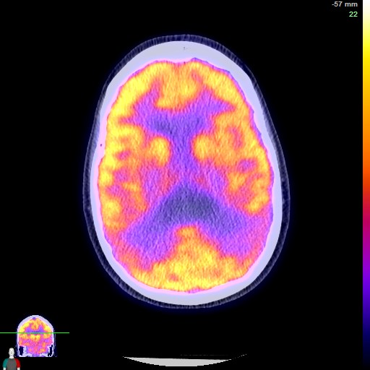
FDG or “Metabolic” PET Consistent with Alzheimer’s Disease
Low signal in parietal region bilaterally indicates probable AD at a later stage, likely w dementia

Slide 24

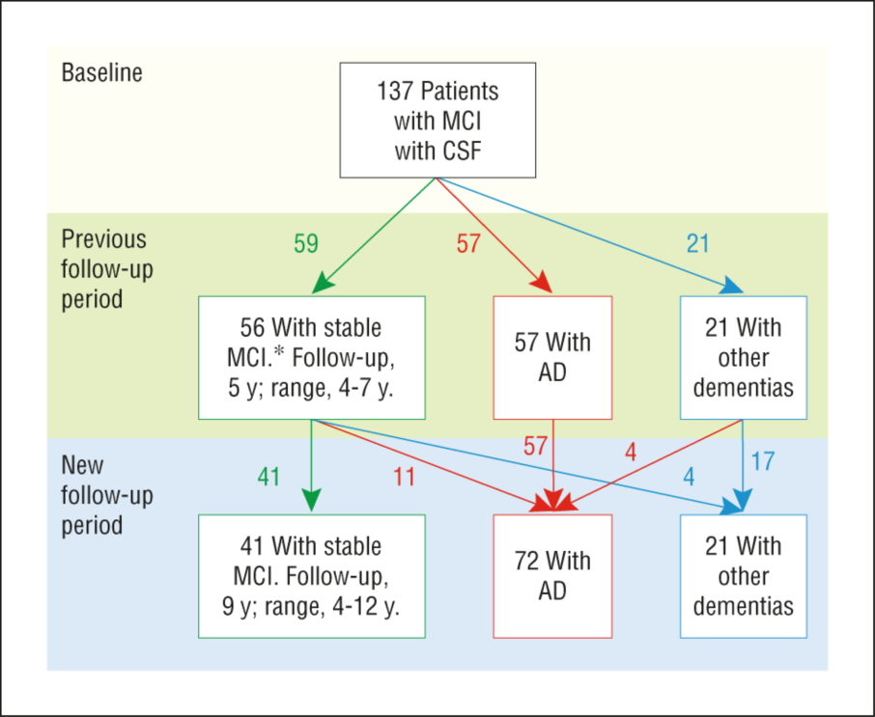
From: Cerebrospinal Fluid Levels ofβ-Amyloid 1-42, but Not of Tau, Are Fully Changed Already 5 to 10 Years Before the Onset of Alzheimer Dementia
Arch Gen Psychiatry. 2012;69(1):98-106. doi:10.1001/archgenpsychiatry.2011.155
42% at 5 yrs. AD dementia
53% at 9 yrs. AD dementia

Slide 25
Modifiable Risk Factors and Memory Trajectories McFall GP et al. Journal of Alzheimer’s Disease 2019

Slide 26
Modifiable Risk Factors and Memory Trajectories McFall GP et al. Journal of Alzheimer’s Disease 2019

Slide 28
Biomarker-based Prognosis Modeling in MCI van Maurik IS et al. Lancet Neurology 2019

Slide 29
Treatment Planning
Treat contributing factors (sleep disorders, thyroid, diabetes, depression, anxiety, meds contributing to cognitive problems, etc.)
Monitor for progression and decline in driving, med management, financial competence
Explore clinical trials
Motivate for lifestyle factors that affect prognosis

Slide 30
Modifying Trajectory: What’s the Evidence?

Slide 31
Readers’ Digest Poll 2015

Slide 33
Risk and Protective Factors Baumgart M et al. Alzheimer’s & Dementia 2015

Slide 34
Physical Activity Recommendations (2010)
“Physical activity should be recommended to adults with normal cognition to reduce the risk of cognitive decline”
Quality of the evidence: moderate
Strength of the recommendation: strong
Should be ≥150 min of moderate intense activity per week in at least 10 minute bouts
More may be better. Less may still be good.
Muscle-strengthening activity ≥2 days/wk

Slide 35
Nutritional Recommendations (2019)
“The Mediterranean-like diet may be recommended to adults with normal cognition or MCI to reduce the risk of cognitive decline and/or dementia.”
Quality of the evidence: moderate
Strength of the recommendation: conditional
Recommendation is based on this diet being the most extensively studied in observational studies showing graded effect: high adherence better effect on cognition than lower adherence. Evidence also for DASH (hypertension diet) and generally healthy diet but not for individual dietary supplements.

Slide 36
Mediterranean Diet and Mild Cognitive Impairment. Scarmeas N et al. Arch Neurol 2009

Slide 37
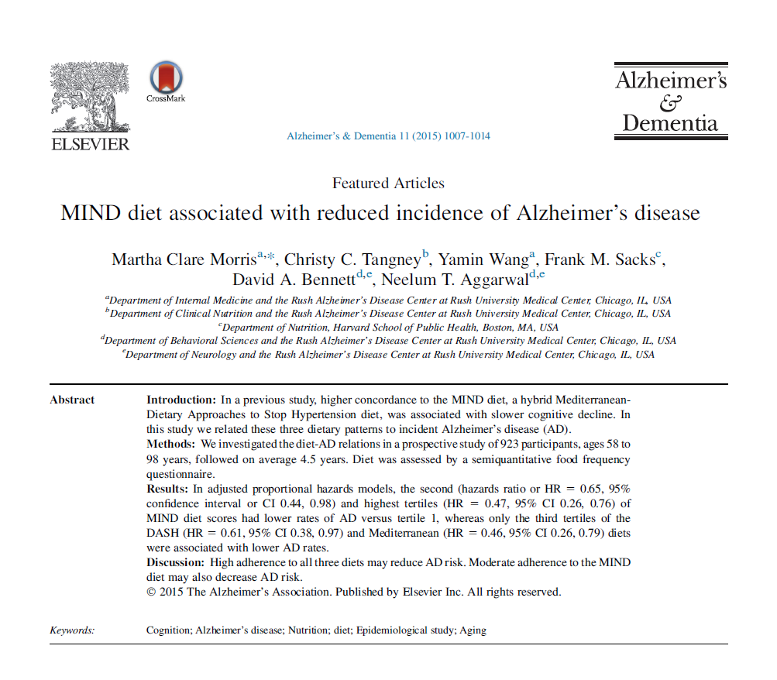

Slide 38
Effect of MeD on Cognition and Brain Morphology: Review of RCT Radd-Vagenas S et al. Am J Clin Nutrician 2018
Five randomized controlled trials of Mediterranean diet effects on cognitive outcomes were reviewed.
Only 8 of 66 measured cognitive outcomes favored the MeD with effect sizes ranging from small (0.32) to large (1.66)
One study found significant effects on memory and increased plasma levels of BDNF, but no benefit in transition from normal to MCI or dementia.
It’s these kind of results from RCTs that soften the recommendation from WHO.

Slide 39
WHO Healthy Diet Recommendations for Brain Health
Observational studies have consistently reported that healthy diet is associated with better cognitive outcomes, but prospective clinical trial evidence less convincing
Quality of evidence: low to high (for different components)
Strength of recommendation: strong
≥5 servings (400 g) of fruits and vegetables/day (starchy roots not counted as vegetables)
≤10% of total caloric intake (50 g) free sugars; less is better
≤30% of total caloric intake from fats, mostly unsaturated fats from fish, nuts, avocado, vegetable oils
≤5 g of salt (≤1 teaspoon)

Slide 40

Phenolic Acids of the Two Major Blueberry Species Kang J et al. Plant Foods Human Nutrition 2015
Lowbush blueberries have >3 times the phenolic acids of high- bush blueberries.
These phenolic acids have anti-inflammatory and antioxidant activity at higher doses.

Slide 41
Additional WHO Recommendations to Reduce Cognitive Decline (MCI and Dementia)
Moderate alcohol intake
moderate quality evidence/conditional recommendation
Suggest cognitive training in those with normal cognition or MCI
low quality/conditional
Support social engagement
insufficient evidence to for risk reduction at this time
Reduce obesity starting in mid-life
moderate quality/conditional
Manage hypertension starting in mid-life
low to high quality evidence/strong recommendation
Other recommendations regarding: diabetes, depression, cholesterol, hearing loss

Slide 42
Ten-Year Effects of the ACTIVE Cognitive Training Rebok GW et al. J Am Ger Soc 2014
2832 older adults, randomized to 10-session training with either memory tasks, reasoning, processing speed or control with booster session at 11 and 35 months.
Only the groups doing the reasoning and processing speed training maintained an advantage over baseline after 10 years (!). For the training groups as a whole, there was only very modest benefit in overall IADLs.

Slide 43
Effects of Intensive vs. Standard BP Control: Sprint MIND Williamson J et al. JAMA 2019
9361 people w HTN randomized to systolic BP target of either ≤ 140 or 120, over 3.3 yrs. with assessment of risk to either MCI or dementia.
19% reduction of risk of MCI or MCI/dementia over the 5+ yrs. follow-up. Results may have been more robust with longer f/u but parent trial was stopped prematurely because of robust effects in reduced CV risks.
Mean age in study was 67.9. Risk benefit likely different after age 80

Slide 45
Porphyromonas gingivalis in Alzheimer’s disease Dominy SS et al. 2019
Infection has long been implicated in AD
Neuroinflammation/microglial activation
Aβ has antimicrobial properties
Inflammasome activation
Putative infectious agents found in CNS of people w AD
But strong evidence of association or causation hasn’t been found

Slide 46
Porphyromonas gingivalis in Alzheimer’s disease Dominy SS et al. 2019
Found P gingivalis DNA in CSF of human AD patients.
Oral infection w P gingivalis in mice stimulates Aβ1-42 production.
P gingivalis and toxic proteases from the bacterium (gingipains) also found in levels corresponding to AD tau tangles.
Gingipains found to be neurotoxic in mice and to increase production of Aβ1-42.
Gingipain inhibitor (COR388) was created and found to reduce bacterial load in mouse CNS, block Aβ1-42 production, reduce neuroinflammation and protect hippocampal cells.
Now in Phase 1 trials with Phase 2/3 to start soon.

Slide 47


Slide 48
Cognitive Results of Group Music Training MacAulay RK et al. 2019
35 socioeconomically diverse older adults taught 12 weekly 1-hour music lessons on recorder by U Maine undergraduates with matched subject pairs for home practice sessions.

Slide 49
Summary
Mild Cognitive Impairment is a syndrome not a disease
Detection and differential diagnosis is important for treating contributing conditions, research, safety, future planning and family genetics
Lifestyle alterations may be helpful in reducing risk of dementia, provide hope and sense of empowerment and agency

Slide 50
MAINAH: Provides mechanism for Healthy Brain Aging Initiative and a Research Cohort for Maine’s Neuroscientists

Slide 51

THE END

