Slide 1
What is High Quality Dementia Care?
Susan Wehry MD, Chief, Division of Geriatrics
PI/Director, AgingME: Maine’s Geriatric Workforce Enhancement Program (GWEP)*
University of New England, College of Osteopathic Medicine
October 28, 2019
"This project is supported by the Health Resources and Services Administration (HRSA) of the U.S. Department of Health and Human Services (HHS) under grant number U1QHP33080-01-00, Geriatrics Workforce Enhancement Program, Year One-total award amount $749,999.00. This information or content and conclusions are those of the author and should not be construed as the official position or policy of, nor should any endorsements be inferred by, HRSA, HHS or the U.S. Government

Slide 2
It depends on whom you ask!

Slide 3
Brain Health Continuum
Healthy Cognitive Functioning
Pre-Symptomatic
Mild Cognitive Impairment
Dementia
Public Health Role:
Accelerate risk reduction
Advance early detection and diagnosis
Ensure safety and quality of care
Notes:
economic systems

Slide 4
National Partnership to Improve Dementia Care, 2012
inappropriate antipsychotic use
person-centered care practices
Over 18 months, national prevalence reduced by 15.1%
Maine reduced 26.1%, fifth most improved state in U.S.

Slide 5
Maine Partnership to Improve Dementia Care
Strong Coalition
Long Term Care Ombudsman Program
Maine Culture Change Coalition
Maine Health Care Association
Multipronged
Music and Memory
Education
Direct Care Staff
Resident and Families
Mentoring

Slide 6
Person-centered/
Person-directed
Fad or foundational?
centers on person, not disease
centers on strengths, not losses
shifts authority to individual
reduces reliance on professionals
builds natural supports
gives equal credence to psychosocial context

Slide 7
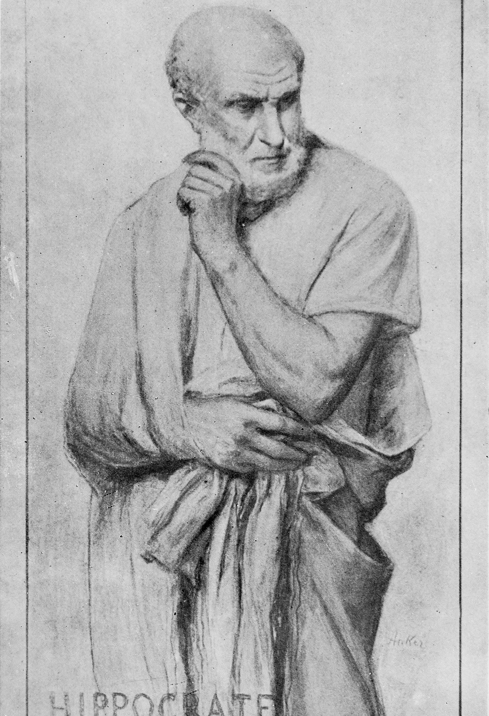
Study symptoms
Individualize treatment
Restore health
Promote well-being
Proper exercise and diet
Treat indiscriminately
Without concern for money

Slide 8
1970s
Patient-centered care as a full-fledged medical model.…”to provide an antidote for high-tech specialty care that didn't respect patients' values and concerns.”

Slide 9
Maintain Personhood
Respect
Joy
Comfort
Attachment
Identity
Love
Inclusion
Meaning
Dignity
Thomas Kitwood, 1996, Dementia Reconsidered

Slide 10
A person with DEMENTIA
A PERSON with dementia
A PERSON

Slide 11
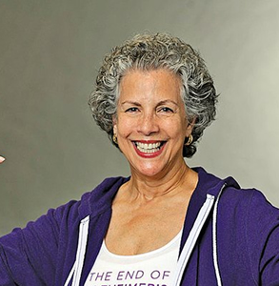
“We desperately need others to see our abilities and not simply focus on our inabilities. Please enable us, don’t further disable us.”
~ Myriam Marquez, living with early onset Alzheimer’s dementia

Slide 12
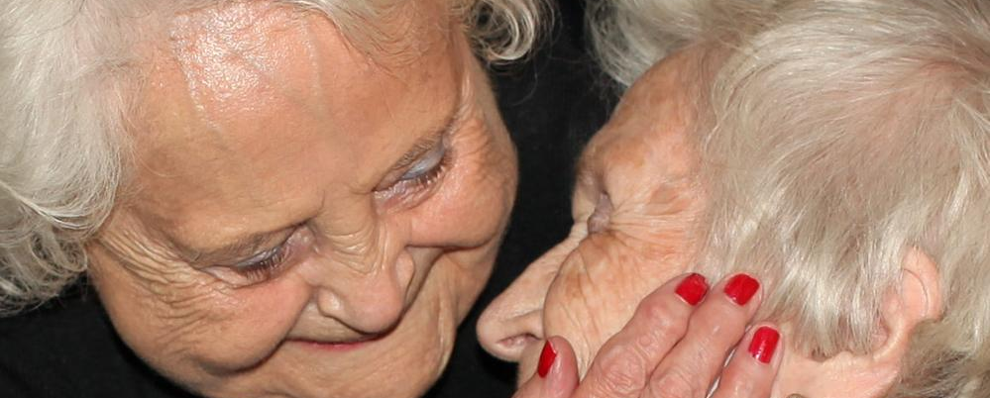
WHO a person is What a person CAN STILL DO

Slide 13
What a person can do
Early Stage
Carries on conversations
Can plan common tasks like dinner
Navigates familiar surroundings
Recognizes familiar people and places
Middle Stage
Remembers things that happened long ago
Recognizes people from early in life
Reads and understands singular words
Mimics simple actions
Carries out over-learned processes like "Hello, how are you."
Makes simple decisions
Late Stage
Interprets and uses basic body language
Enjoys sounds, tastes, smells, sights and touch

Slide 14
What a person can’t do
Early Stage
May need help doing familiar tasks
May need assistance recalling familiar places or people
May need assistance with planning or organizing
May need help remembering words or names
May get frustrated easily
Middle Stage
May need hands-on care
May get lost easily
More repetition of questions or statements
Anger, suspicion
Changes in personality
Late Stage
Needs hands on personal care
Significant confusion
Loss of ability to communicate
May not recognize self or family
May lose ability to smile

Slide 15
Palliative care
Preserves values and identity of the individual, even in the advanced stages
PEACE model

Slide 16
Care partners/Care givers
REACH 2
Powerful Tools
Savvy Caregivers
Telehealth

Slide 17
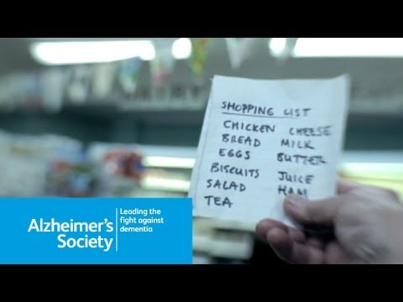

Slide 18
Q&A

Slide 19
What can you do…?
Person-first language
Say hello...

Slide 20
What can you do…?
Establish and employ shared goals
Empower and support carepartners
Educate public and workforce
Develop dementia-friendly communities
Evaluate results and share success
Support coalitions

Slide 21
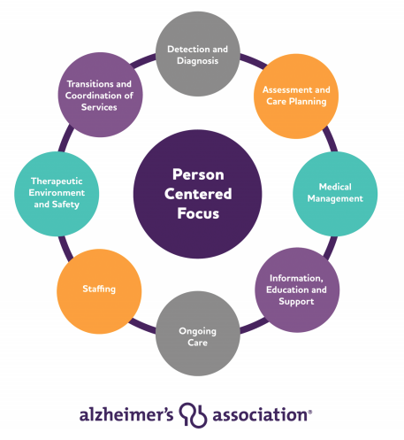
Resources
Alzheimer's Association
Dementia Action Alliance
The Gerontologist Care Practice Recommendations
Aroostook Area Agency on Aging
Eastern Area Agency on Aging

Slide 22
For being here
For your interest
For all you do
Please stay in touch
swehry@une.edu
@beingwithaging

